Slide 1
Fundamentals of Ecology
Week 6, Ecology Lecture 2
Cara Brook
February 9, 2023

Slide 2
Let’s recap a bit!
Ecology, generally
Ecology is the study of organisms and their interactions with each other and the environment
We use models to formalize hypotheses about these interactions and test those hypotheses against data
We can ask questions at many ecological scales: individual, population, metapopulation, community, ecosystem
Population growth, specifically
We can model population growth as geometric in discrete time or exponential in continuous time
Logistic growth models describe density-dependent growth rates that limit population growth at some specified carrying capacity
Logistic growth models imply a stable equilibrium where the population size (N) is equal to the carrying capacity (K)
Fisheries have used this model to attempt to define a maximum sustainable harvest rate (MSY) to guide policy, but it has performed poorly because the models are not realistic
One shortcoming of the simple logistic growth model is a failure to include both environmental and demographic stochasticity

Slide 3
Let’s recap a bit!
Ecology, generally
Ecology is the study of organisms and their interactions with each other and the environment
We use models to formalize hypotheses about these interactions and test those hypotheses against data
We can ask questions at many ecological scales: individual, population, metapopulation, community, ecosystem
Population growth, specifically
We can model population growth as geometric in discrete time or exponential in continuous time
Logistic growth models describe density-dependent growth rates that limit population growth at some specified carrying capacity
Logistic growth models imply a stable equilibrium where the population size (N) is equal to the carrying capacity (K)
Despite the dire predictions of Malthus in the late 1700s, most human populations do not appear to yet be approaching carrying capacity

Slide 4
Let’s recap a bit!
Ecology, generally
Ecology is the study of organisms and their interactions with each other and the environment
We use models (especially population models) to formalize hypotheses about these interactions and test those hypotheses against data
We can ask questions at many ecological scales: individual, population, metapopulation, community, ecosystem
Population growth, specifically
We can model population growth as geometric in discrete time or exponential in continuous time
Logistic growth models describe density-dependent growth rates that limit population growth at some specified carrying capacity
Logistic growth models imply a stable equilibrium where the population size (N) is equal to the carrying capacity (K)
Despite the dire predictions of Malthus in the late 1700s, most human populations do not appear to yet be approaching carrying capacity

Slide 5
Let’s recap a bit!
Ecology, generally
Ecology is the study of organisms and their interactions with each other and the environment
We use models (especially population models) to formalize hypotheses about these interactions and test those hypotheses against data
We can ask questions at many ecological scales: individual, population, metapopulation, community, ecosystem
Population growth, specifically
We can model population growth as geometric in discrete time or exponential in continuous time
Logistic growth models describe density-dependent growth rates that limit population growth at some specified carrying capacity
Logistic growth models imply a stable equilibrium where the population size (N) is equal to the carrying capacity (K)
Despite the dire predictions of Malthus in the late 1700s, most human populations do not appear to yet be approaching carrying capacity

Slide 6
Let’s recap a bit!
Ecology, generally
Ecology is the study of organisms and their interactions with each other and the environment
We use models (especially population models) to formalize hypotheses about these interactions and test those hypotheses against data
We can ask questions at many ecological scales: individual, population, metapopulation, community, ecosystem
Population growth, specifically
We can model population growth as geometric in discrete time or exponential in continuous time
Logistic growth models describe density-dependent growth rates that limit population growth at some specified carrying capacity
Logistic growth models imply a stable equilibrium where the population size (N) is equal to the carrying capacity (K)
Despite the dire predictions of Malthus in the late 1700s, most human populations do not appear to yet be approaching carrying capacity

Slide 7
Let’s recap a bit!
Ecology, generally
Ecology is the study of organisms and their interactions with each other and the environment
We use models (especially population models) to formalize hypotheses about these interactions and test those hypotheses against data
We can ask questions at many ecological scales: individual, population, metapopulation, community, ecosystem
Population growth, specifically
We can model population growth as geometric in discrete time or exponential in continuous time
Logistic growth models describe density-dependent growth rates that limit population growth as abundance approaches some specified carrying capacity
Logistic growth models imply a stable equilibrium where the population size (N) is equal to the carrying capacity (K)
Despite the dire predictions of Malthus in the late 1700s, most human populations do not appear to yet be approaching carrying capacity

Slide 8
Let’s recap a bit!
Ecology, generally
Ecology is the study of organisms and their interactions with each other and the environment
We use models (especially population models) to formalize hypotheses about these interactions and test those hypotheses against data
We can ask questions at many ecological scales: individual, population, metapopulation, community, ecosystem
Population growth, specifically
We can model population growth as geometric in discrete time or exponential in continuous time
Logistic growth models describe density-dependent growth rates that limit population growth as abundance approaches some specified carrying capacity
Logistic growth models imply a stable equilibrium where the population size (N) is equal to the carrying capacity (K)
Despite the dire predictions of Malthus in the late 1700s, most human populations do not appear to yet be approaching carrying capacity

Slide 9
Let’s recap a bit!
Ecology, generally
Ecology is the study of organisms and their interactions with each other and the environment
We use models (especially population models) to formalize hypotheses about these interactions and test those hypotheses against data
We can ask questions at many ecological scales: individual, population, metapopulation, community, ecosystem
Population growth, specifically
We can model population growth as geometric in discrete time or exponential in continuous time
Logistic growth models describe density-dependent growth rates that limit population growth as abundance approaches some specified carrying capacity
Logistic growth models imply a stable equilibrium where the population size (N) is equal to the carrying capacity (K)
Despite the dire predictions of Malthus in the late 1700s, most human populations do not appear to yet be approaching carrying capacity

Slide 10
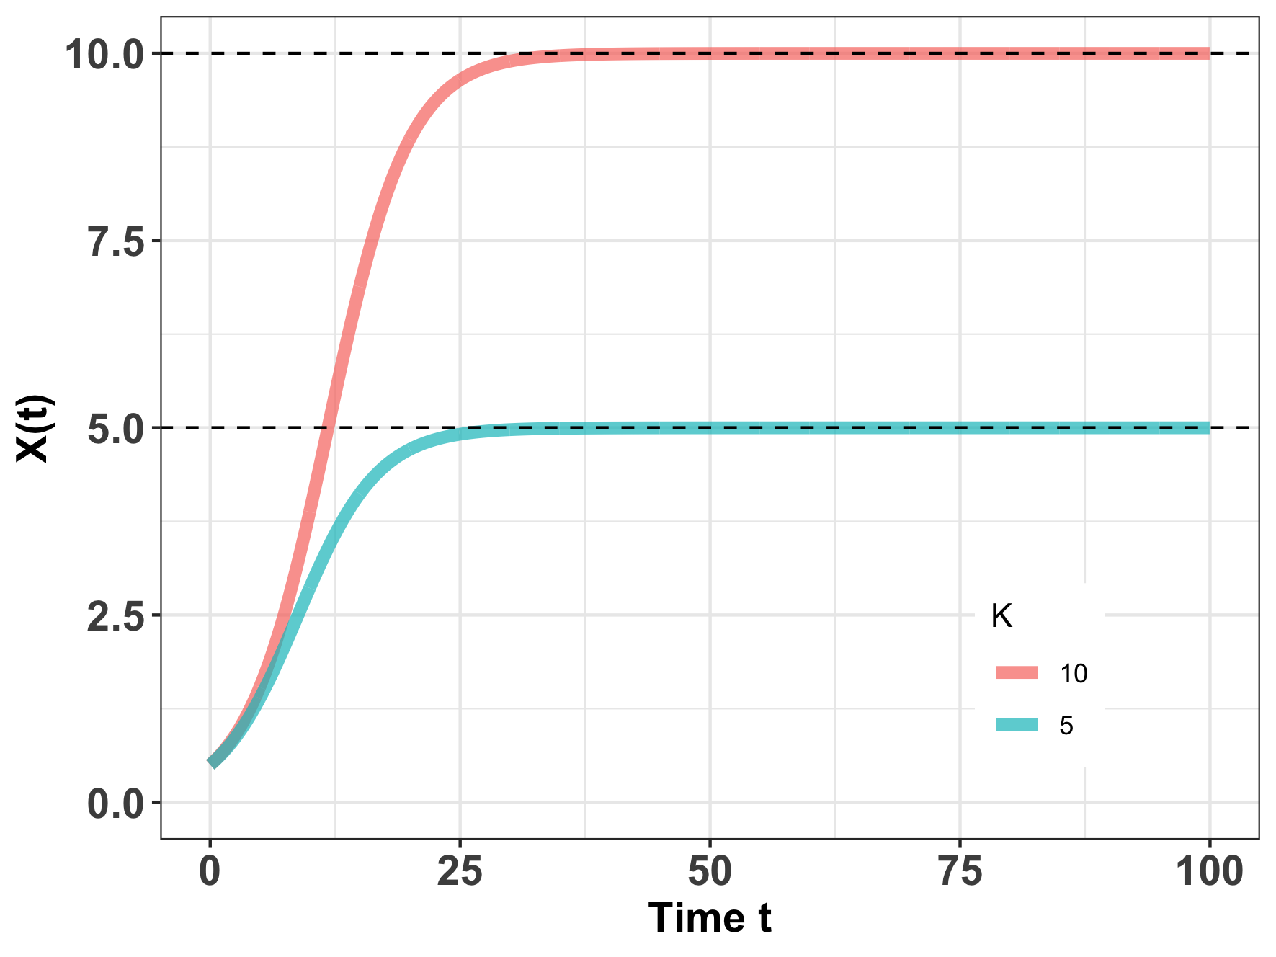
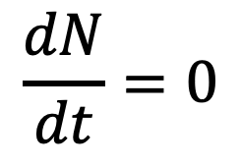
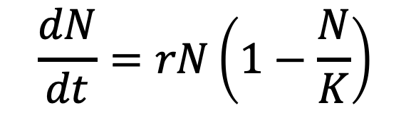
Logistic growth and equilibrium
$$\frac{dN}{dt}=rN\left(1−\frac{N}{K}\right)$$
$$\frac{dN}{dt}=0$$
When population size is not changing, the population is said to be at equilibrium.
Mathematically, the carrying capacity (K) can be shown to be a stable equilibrium, meaning that if the system is perturbed, it will return to this point.
Notes:
Logistic growth suggests that there are density-dependent growth rates and that carrying capacity is a stable equilibrium in the dynamical system.
When an This means that

Slide 11
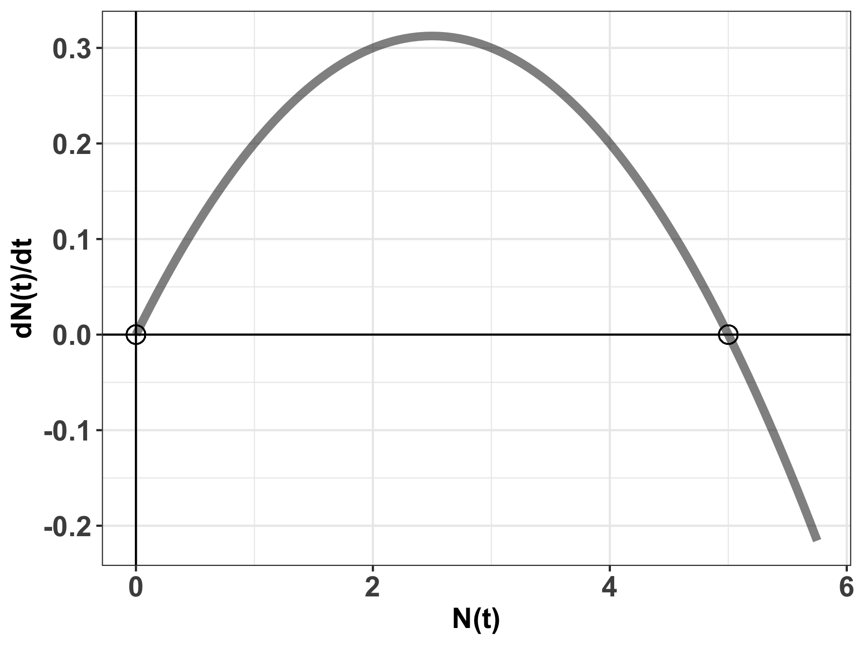

Logistic growth and equilibrium
$$\frac{dN}{dt}=rN\left(1−\frac{N}{K}\right)$$
$$\frac{dN}{dt}=0$$
$$K=5$$
When population size is not changing, the population is said to be at equilibrium.
Mathematically, the carrying capacity (K) can be shown to be a stable equilibrium, meaning that if the system is perturbed, growth will accelerate or decelerate to return the population to K.
Notes:
N= K is a stable equilibrium. Small negative perturbations to the system will result in r > 0 which will grow to N=K. Small negative perturbations to the system will result in r <0 and sink to N=K
N= 0 is an unstable equilibrium. Small perturbations to the system around N=0 will result in r > 0 which will grow to N = K.

Slide 12
Logistic growth and harvesting
Humans have attempted to leverage density-dependent growth rates for sustainable harvesting, which refers to the offtake of individuals within a population’s capacity for replenishment. Frequently, this refers to the harvesting of animals for human consumption.
Notes:
Now that we understand density-dependent growth, we’ll explore how humans have attempted to leverage this stability

Slide 13
Logistic growth and harvesting
Humans have attempted to leverage density-dependent growth rates for sustainable harvesting, which refers to the offtake of individuals within a population’s capacity for replenishment. Frequently, this refers to the harvesting of animals for human consumption.
The science of sustainable harvest is used extensively in fisheries management.
Notes:
Now that we understand density-dependent growth, we’ll explore how humans have attempted to leverage this stability

Slide 14
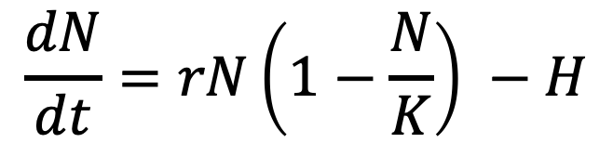
Logistic growth and harvesting
Humans have attempted to leverage density-dependent growth rates for sustainable harvesting, which refers to the offtake of individuals within a population’s capacity for replenishment. Frequently, this refers to the harvesting of animals for human consumption.
The science of sustainable harvest is used extensively in fisheries management.
population size
change in population size with time
$$\frac{dN}{dt}=rN\left(1−\frac{N}{K}\right) −H$$
harvesting rate
carrying capacity
intrinsic growth rate
density-dependence
Notes:
Now that we understand density-dependent growth, we’ll explore how humans have attempted to leverage this stability

Slide 15
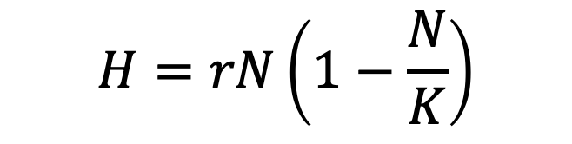
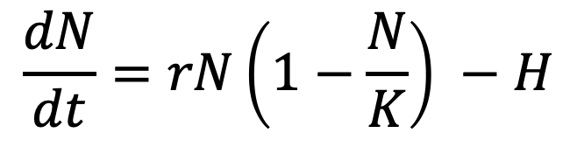
Logistic growth and harvesting
$$\frac{dN}{dt}=rN\left(1−\frac{N}{K}\right) −H$$
For a harvested population, theoretically, the population size is at equilibrium if the harvest rate equals the growth rate.
$$H=rN\left(1−\frac{N}{K}\right)$$

Slide 16
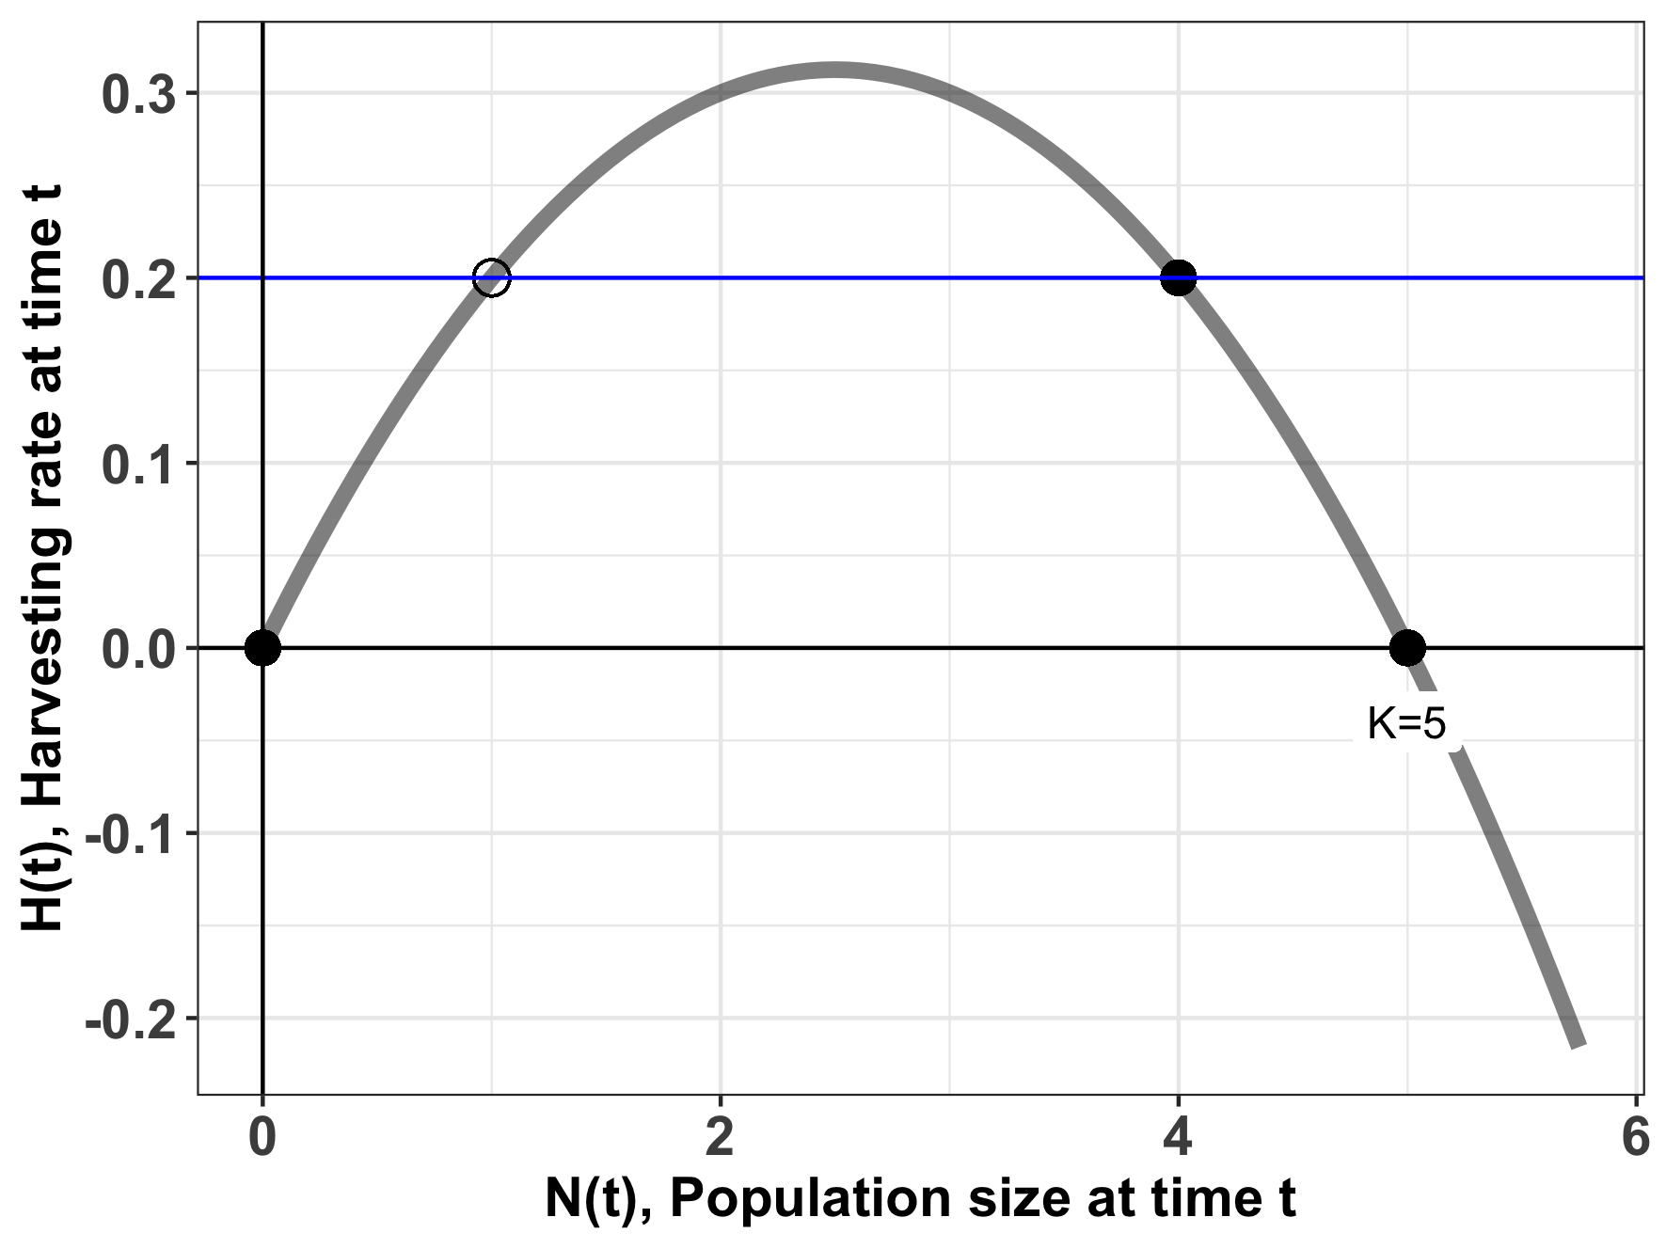
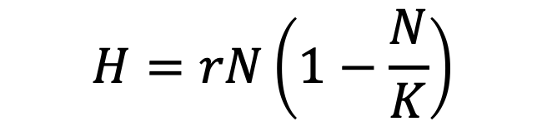
The stability of harvesting depends on population size.
$$H=rN\left(1−\frac{N}{K}\right)$$
harvesting rate
carrying capacity

Slide 17
The stability of harvesting depends on population size.
$$H=rN\left(1−\frac{N}{K}\right)$$
stable equilibrium
For a population of N=4, a harvest rate of 0.2 (animals/timestep) results in a stable equilibrium (sustainable harvest).
Notes:
N=4 is a stable equilibrium. Small negative perturbations to the system will result in r > 0 which will grow to N=4. Small negative perturbations to the system will result in r <0 and sink to N=4.
You can test this just by filling in values. This curve was built assuming r = 0.25 and K= 5. Try it testing N=2 (dN/dt eqn is positive) or N=6 (dN/dt eqn is negative)

Slide 18
The stability of harvesting depends on population size.
$$H=rN\left(1−\frac{N}{K}\right)$$
stable equilibrium
For a population of N=4, a harvest rate of 0.2 (animals/timestep) results in a stable equilibrium (sustainable harvest).
Increases or decreases in population size will be compensated to return the system to N=4.
Notes:
You can test this just by filling in values. This curve was built assuming r = 0.25 and K= 5. Try it testing N=2 (dN/dt eqn is positive) or N=6 (dN/dt eqn is negative)

Slide 19
The stability of harvesting depends on population size.
$$H=rN\left(1−\frac{N}{K}\right)$$
unstable equilibrium
For a population of N=1, a harvest rate of 0.2 (animals/timestep) results in an unsustainable equilibrium.
Notes:
N= 1 is an unstable equilibrium.
Small negative perturbations to the system around N=2 will sink to N=0.
Small positive perturbations to the system around N=2 will will grow to N=4.
You can test this just by filling in values. This curve was built assuming r = 0.25 and K= 5. Try it testing N=2 (dN/dt eqn is positive) or N=.5 (dN/dt eqn is negative)

Slide 20
The stability of harvesting depends on population size.
$$H=rN\left(1−\frac{N}{K}\right)$$
unstable equilibrium
For a population of N=1, a harvest rate of 0.2 (animals/timestep) results in an unsustainable equilibrium.
Random increases or decreases in population size will result in the population moving away from N=1 to, respectively, N=4 or N=0 (the latter is a population collapse).
Notes:
𝐌2−4𝐇𝐌𝐤 > 0 ⇒ 𝐇<𝐤𝐌4 − �2−4��� > 0 ⇒ �<��4 − ("subcritical harvesting"): we have two equilibrium solutions smaller than 𝑀 � , the "carrying capacity" in the standard logistic model, that we could call 𝑀+ �+ and 𝑀− �− ; the differential equation becomes 𝑑𝑃𝑑𝑡 = −𝑘𝑀·(𝑃−𝑀+)·(𝑃−𝑀−) ,���� = −��·(�−�+)·(�−�−) , which is separable and can be solved by using partial-fraction decomposition; we in turn have three cases for the initial condition, 𝑃0<𝑀− , 𝑀−<𝑃0<𝑀+ , �0<�− , �−<�0<�+ , and 𝑃0>𝑀+ ; �0>�+ ; we find that 𝑀+ �+ is the "attractor" (stable) equilibrium solution and 𝑀− �− is the "repeller" (unstable) equilibrium
N= 1 is an unstable equilibrium.
Small negative perturbations to the system around N=2 will sink to N=0.
Small positive perturbations to the system around N=2 will will grow to N=4.
You can test this just by filling in values. This curve was built assuming r = 0.25 and K= 5. Try it testing N=2 (dN/dt eqn is positive) or N=.5 (dN/dt eqn is negative)

Slide 21
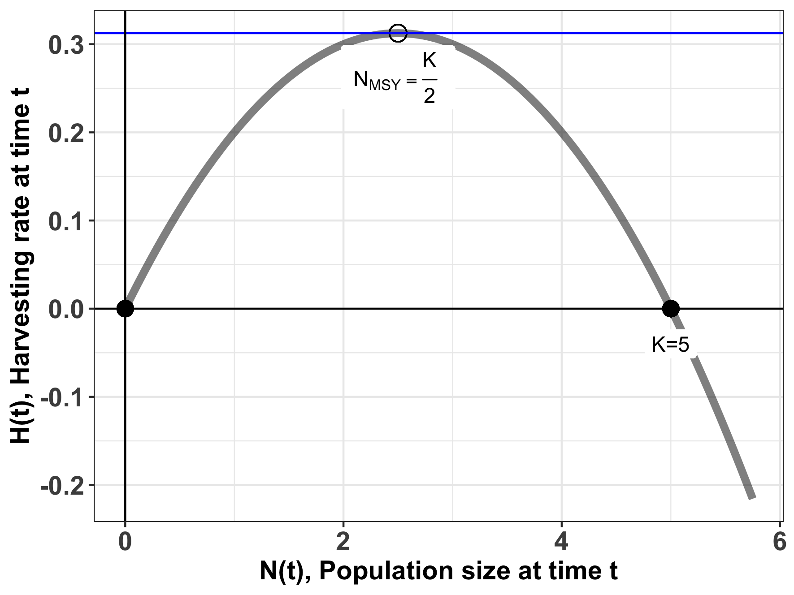
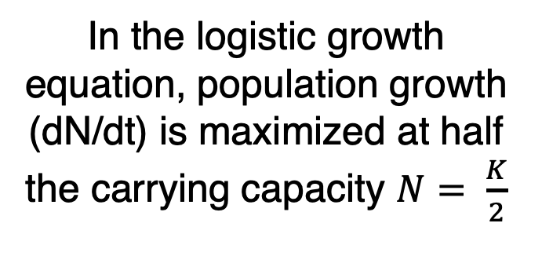
Maximum sustainable yield (MSY)
$$H=rN\left(1−\frac{N}{K}\right)$$
In the logistic growth equation, population growth (dN/dt) is maximized at half the carrying capacity $N= \frac{K}{2}$
Notes:
You can test this by filling in values of N on either side of N=2.5 (try N=3 and N=2) for harvesting = 0.25*5/4 = 0.312

Slide 22
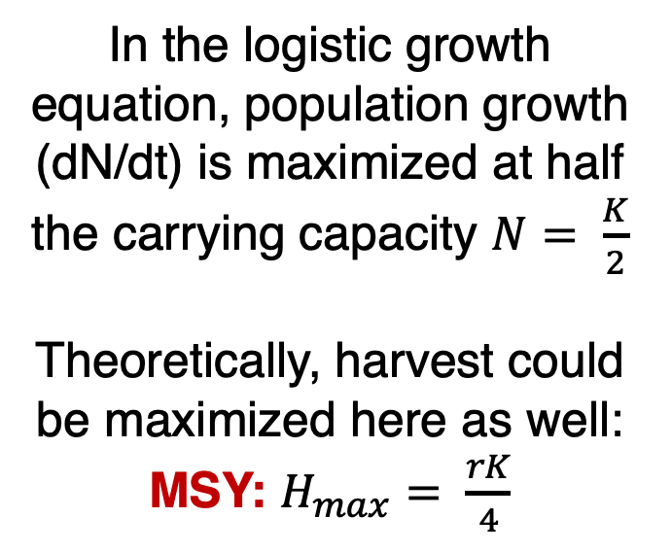
Maximum sustainable yield (MSY)
$$H=rN\left(1−\frac{N}{K}\right)$$
In the logistic growth equation, population growth (dN/dt) is maximized at half the carrying capacity $N= \frac{K}{2}$
Theoretically, harvest could be maximized here as well:
MSY: $H_{max}= \frac{rK}{4}$
take the derivative with respect to N

Slide 23

Maximum sustainable yield (MSY)
$$H=rN\left(1−\frac{N}{K}\right)$$
MSY: $H_{max}= \frac{rK}{4}$
The MSY is a semi-stable equilibrium, meaning that small gains in population size (N) will be compensated to return the system to N_{MSY,} while small losses will result in the system collapsing to N=0.

Slide 24
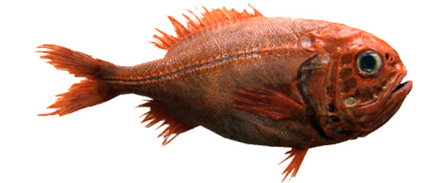
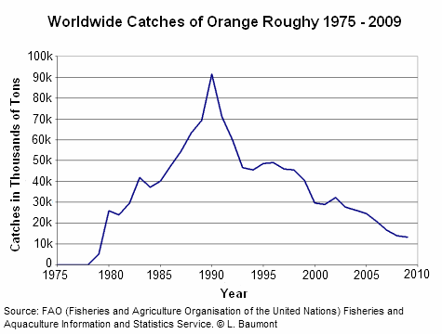
Case Study: Orange Roughy
Found in deep waters of eastern Pacific (Chile), western Pacific (Australia/NZ), and southeastern Atlantic (Namibia to South Africa)
Can live up to 200 years! Matures at 20-30 yrs
Fished via trawling, originally thought to have only a 30-year lifespan
Annual global catches began in 1979 and increased to over 90,000 tons in the late 1980s.
High catch levels quickly decreased as stocks were fished down. By the late 1990s, three of the eight NZ orange roughy fisheries had collapsed and were closed.

Slide 25
Case Study: Orange Roughy
Found in deep waters of eastern Pacific (Chile), western Pacific (Australia/NZ), and southeastern Atlantic (Namibia to South Africa)
Can live up to 200 years! Matures at 20-30 yrs
Fished via trawling, originally thought to have only a 30-year lifespan
Annual global catches began in 1979 and increased to over 90,000 tons in the late 1980s.
High catch levels quickly decreased as stocks were fished down. By the late 1990s, three of the eight NZ orange roughy fisheries had collapsed and were closed.

Slide 26
Case Study: Orange Roughy
Found in deep waters of eastern Pacific (Chile), western Pacific (Australia/NZ), and southeastern Atlantic (Namibia to South Africa)
Can live up to 200 years! Matures at 20-30 yrs
Fished via trawling, originally thought to have only a 30-year lifespan
Annual global catches began in 1979 and increased to over 90,000 tons in the late 1980s.
High catch levels quickly decreased as stocks were fished down. By the late 1990s, three of the eight NZ orange roughy fisheries had collapsed and were closed.

Slide 27
Case Study: Orange Roughy
Found in deep waters of eastern Pacific (Chile), western Pacific (Australia/NZ), and southeastern Atlantic (Namibia to South Africa)
Can live up to 200 years! Matures at 20-30 yrs
Fished via trawling, originally thought to have only a 30-year lifespan
Annual global catches began in 1979 and increased to over 90,000 tons in the late 1980s.
High catch levels quickly decreased as stocks were fished down. By the late 1990s, three of the eight NZ orange roughy fisheries had collapsed and were closed.

Slide 28
Case Study: Orange Roughy
Found in deep waters of eastern Pacific (Chile), western Pacific (Australia/NZ), and southeastern Atlantic (Namibia to South Africa)
Can live up to 200 years! Matures at 20-30 yrs
Fished via trawling, originally thought to have only a 30-year lifespan
Annual global catches began in 1979 and increased to over 90,000 tons in the late 1980s.
High catch levels quickly decreased as stocks were fished down. By the late 1990s, three of the eight NZ orange roughy fisheries had collapsed and were closed.

Slide 29
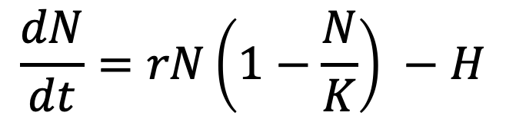
The case of the orange roughy highlights many of the inherent problems with MSY
r and K and N are difficult to measure.
Many harvesting models neglect population structure.
Simple harvesting models assume constant harvest.
MSY fails to acknowledge the reality of overfishing.
Because of the semi-stable equilibrium at MSY, small (natural) decreases in N can be devastating
environmental stochasticity
demographic stochasticity
$$\frac{dN}{dt}=rN\left(1−\frac{N}{K}\right) −H$$

Slide 30
The case of the orange roughy highlights many of the inherent problems with MSY
r and K and N are difficult to measure.
Many harvesting models neglect population structure or model only a single species in isolation.
or model only a single species in isolation.
Simple harvesting models assume constant harvest.
MSY fails to acknowledge the reality of overfishing.
Because of the semi-stable equilibrium at MSY, small (natural) decreases in N can be devastating
environmental stochasticity
demographic stochasticity
$$\frac{dN}{dt}=rN\left(1−\frac{N}{K}\right) −H$$

Slide 31
The case of the orange roughy highlights many of the inherent problems with MSY
r and K and N are difficult to measure.
Many harvesting models neglect population structure or model only a single species in isolation.
Simple harvesting models assume constant harvest.
MSY fails to acknowledge the reality of overfishing.
Because of the semi-stable equilibrium at MSY, small (natural) decreases in N can be devastating
environmental stochasticity
demographic stochasticity
$$\frac{dN}{dt}=rN\left(1−\frac{N}{K}\right) −H$$

Slide 32
The case of the orange roughy highlights many of the inherent problems with MSY
r and K and N are difficult to measure.
Many harvesting models neglect population structure or model only a single species in isolation.
Simple harvesting models assume constant harvest.
MSY fails to acknowledge the reality of overfishing.
Because of the semi-stable equilibrium at MSY, small (natural) decreases in N can be devastating
environmental stochasticity
demographic stochasticity
$$\frac{dN}{dt}=rN\left(1−\frac{N}{K}\right) −H$$

Slide 33
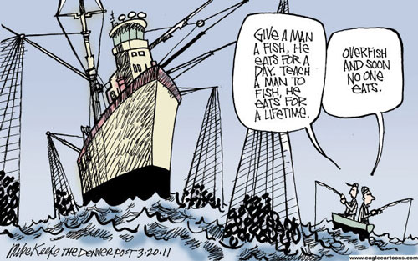
Overfishing: A Tragedy of the Commons
Tragedy of the Commons: A situation in which individual users, who have open access to a common pool resource, cause depletion of the resource through their uncoordinated actions.
Idea was popularized by ecologist Garret Hardin in 1968, a Malthus-like reference to the overpopulation of the Earth
Fisheries provide a classic example of Tragedy of the Commons because property rights are incomplete and access is open.
Many examples of fisheries collapse:
Sturgeon in Caspian sea in 2000s
Atlantic cod in Canada & elsewhere in 1990s
Orange roughy in NZ in 1990s
Despite its dangers, MSY is still highlight as a policy in many international treaties.
Notes:
Garret Hardin = Malthusian, anti-welfare philosophy
Contrast with Elinor Ostrom’s work on successful cooperation for managing land

Slide 34
Overfishing: A Tragedy of the Commons
Tragedy of the Commons: A situation in which individual users, who have open access to a common pool resource, cause depletion of the resource through their uncoordinated actions.
Idea was popularized by ecologist Garret Hardin in 1968, a Malthus-like reference to the overpopulation of the Earth
Fisheries provide a classic example of Tragedy of the Commons because property rights are incomplete and access is open.
Many examples of fisheries collapse:
Sturgeon in Caspian sea in 2000s
Atlantic cod in Canada & elsewhere in 1990s
Orange roughy in NZ in 1990s
Despite its dangers, MSY is still highlight as a policy in many international treaties.
Notes:
Garret Hardin = Malthusian, anti-welfare philosophy
Contrast with Elinor Ostrom’s work on successful cooperation for managing land

Slide 35
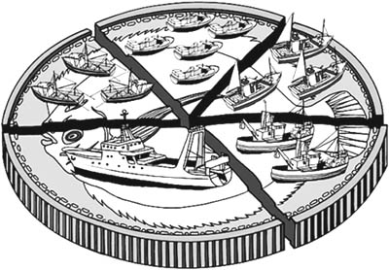
Overfishing: A Tragedy of the Commons
International management of fisheries has been attempted through government coordination to set a Total Allowable Catch (TAC) for each fishery each year.
This practice can lead to intense pressure to fish all at once at the season’s opening, sometimes overshooting the TAC.
This challenge can be mitigated by the use of Individual Fishing Quotas (IFQs) or Individual Transferrable Quotas (ITQs), but allocation is still an issue.
The work of Elinor Ostrom showed that some of these challenges can be overcome when the limits of a resource are clearly defined, when the group of stakeholders is small, and when communication is high.
Notes:
These port-level networks vary in properties such as network resilience (colour of port-location dots: red is lower resilience, green is greater resilience), and they are also comprised of both state and federally managed fisheries (small networks on right: red and blue nodes, respectively).

Slide 36
Overfishing: A Tragedy of the Commons
International management of fisheries has been attempted through government coordination to set a Total Allowable Catch (TAC) for each fishery each year.
This practice can lead to intense pressure to fish all at once at the season’s opening, sometimes overshooting the TAC.
This challenge can be mitigated by the use of Individual Fishing Quotas (IFQs) or Individual Transferrable Quotas (ITQs), but allocation is still an issue.
The work of Elinor Ostrom showed that some of these challenges can be overcome when the limits of a resource are clearly defined, when the group of stakeholders is small, and when communication is high.
Notes:
These port-level networks vary in properties such as network resilience (colour of port-location dots: red is lower resilience, green is greater resilience), and they are also comprised of both state and federally managed fisheries (small networks on right: red and blue nodes, respectively).

Slide 37
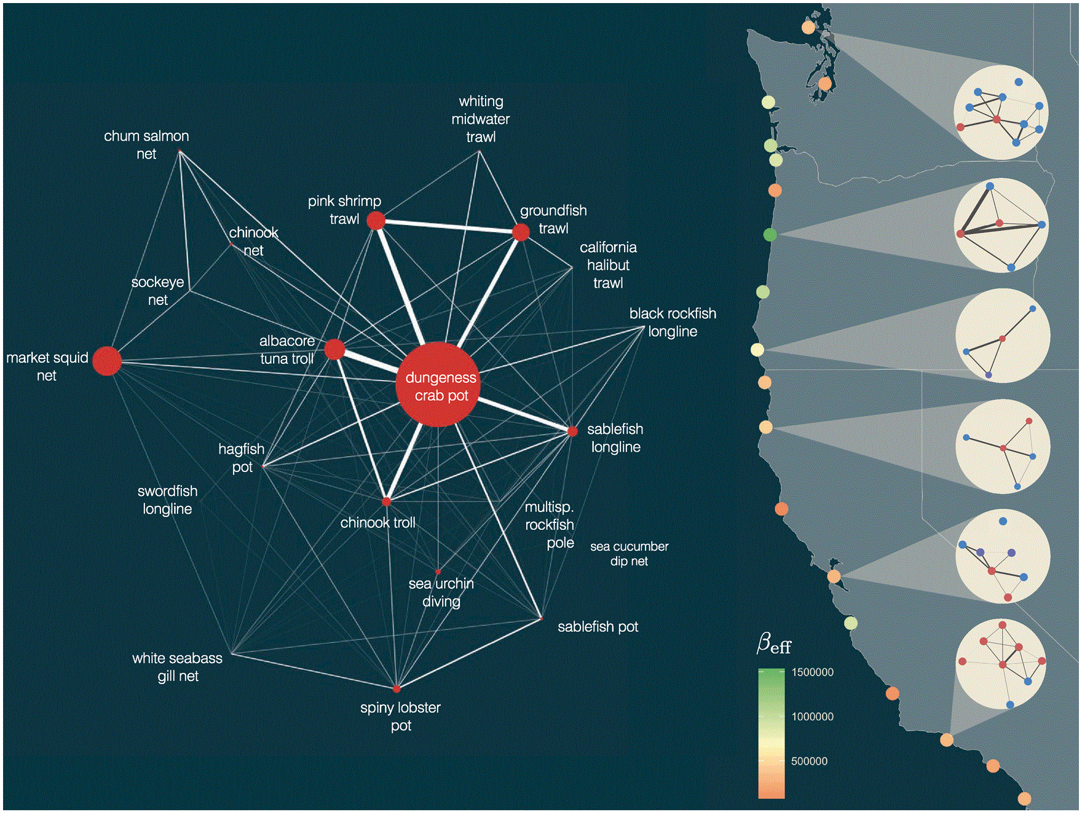
Overfishing: A Tragedy of the Commons
International management of fisheries has been attempted through government coordination to set a Total Allowable Catch (TAC) for each fishery each year.
This practice can lead to intense pressure to fish all at once at the season’s opening, sometimes overshooting the TAC.
This challenge can be mitigated by the use of Individual Fishing Quotas (IFQs) or Individual Transferrable Quotas (ITQs), but allocation is still an issue.
The work of Elinor Ostrom showed that some of these challenges can be overcome when the limits of a resource are clearly defined, when the group of stakeholders is small, and when communication is high.
Dr. Emma Fuller, Fractal Agriculture
Fuller et al. 2017. ICES Journal of Marine Science
Notes:
These port-level networks vary in properties such as network resilience (colour of port-location dots: red is lower resilience, green is greater resilience), and they are also comprised of both state and federally managed fisheries (small networks on right: red and blue nodes, respectively).

Slide 38
The case of the orange roughy highlights many of the inherent problems with MSY
r and K and N are difficult to measure.
Many harvesting models neglect population structure or model only a single species in isolation.
Simple harvesting models assume constant harvest.
MSY fails to acknowledge the reality of overfishing.
Because of the semi-stable equilibrium at MSY, small (natural) decreases in N can be devastating
environmental stochasticity
demographic stochasticity
$$\frac{dN}{dt}=rN\left(1−\frac{N}{K}\right) −H$$

Slide 39
Deterministic vs. Stochastic

Slide 40

Deterministic vs. Stochastic
if deterministic
“always the same”
annual survival rate = 0.5

Slide 41
Deterministic vs. Stochastic
if deterministic
“always the same”
annual survival rate = 0.5

Slide 42
Deterministic vs. Stochastic
if deterministic
“always the same”
annual survival rate = 0.5
All the models we have looked at so far have been deterministic!

Slide 43
Deterministic vs. Stochastic
if deterministic
“always the same”
annual survival rate = 0.5
if stochastic
“up to chance”
annual survival rate = 0.5

Slide 44
Deterministic vs. Stochastic
if deterministic
“always the same”
annual survival rate = 0.5
if stochastic
“up to chance”
annual survival rate = 0.5

Slide 45
Deterministic vs. Stochastic
if deterministic
“always the same”
annual survival rate = 0.5
if stochastic
“up to chance”
annual survival rate = 0.5

Slide 46
The case of the orange roughy highlights many of the inherent problems with MSY
r and K and N = difficult to measure.
Neglect population structure.
Single species models.
Assumes constant harvest.
Ignores reality of overfishing.
Because of the semi-stable equilibrium at MSY, small (natural) decreases in N can be devastating
environmental stochasticity
temporal changes in mortality or reproductive rate (e.g. due to climate)
if stochastic
“up to chance”
annual survival rate = 0.5
cyclone year!
Notes:
Demographic stochasticity describes the within-individual variability (growth rate might vary from one individual to the next)
while environmental stochasticity refers to temporary environmental fluctuations that lead to changes in population growth rates (climate change and egg survival)

Slide 47
The case of the orange roughy highlights many of the inherent problems with MSY
r and K and N = difficult to measure.
Neglect population structure.
Single species models.
Assumes constant harvest.
Ignores reality of overfishing.
Because of the semi-stable equilibrium at MSY, small (natural) decreases in N can be devastating
environmental stochasticity
temporal changes in mortality or reproductive rate (due to climate)
demographic stochasticity
individual-level differences in mortality and reproduction, esp. at small pop size
if deterministic
“always the same”
annual fecundity = 0.5
Notes:
Demographic stochasticity describes the within-individual variability (growth rate might vary from one individual to the next)
while environmental stochasticity refers to temporary environmental fluctuations that lead to changes in population growth rates (climate change and egg survival)

Slide 48


The case of the orange roughy highlights many of the inherent problems with MSY
r and K and N = difficult to measure.
Neglect population structure.
Single species models.
Assumes constant harvest.
Ignores reality of overfishing.
Because of the semi-stable equilibrium at MSY, small (natural) decreases in N can be devastating
environmental stochasticity
temporal changes in mortality or reproductive rate (due to climate)
demographic stochasticity
individual-level differences in mortality and reproduction, esp. at small pop size
if stochastic
“up to chance”
annual fecundity = 0.5
Only one male encounters only one female, so only 1 new fish is born!
Notes:
Demographic stochasticity describes the within-individual variability (growth rate might vary from one individual to the next)
while environmental stochasticity refers to temporary environmental fluctuations that lead to changes in population growth rates (climate change and egg survival)

Slide 49
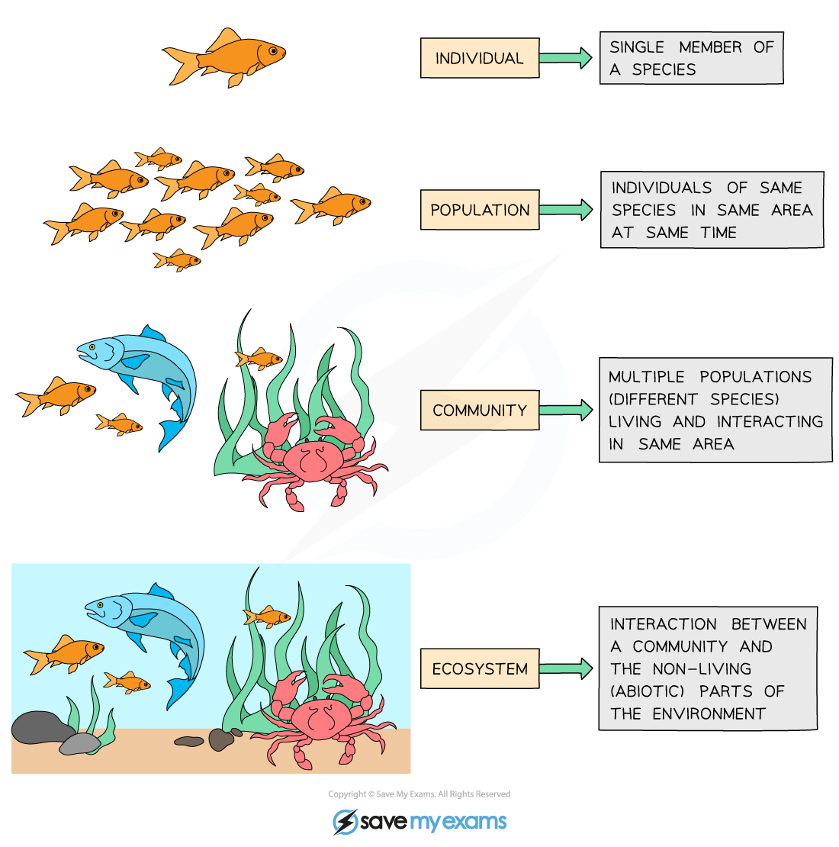
Ecology is the study of the interactions of organisms with each other and their environment.
individual
population
metapopulation
community
ecosystem
Notes:
We explore ecology – using models – across scales

Slide 50
individual
Population = multiple individuals of the same species (conspecifics) in the same habitat
population
metapopulation
fish
(x)
community
How does the abundance of fish change through time?
ecosystem

Slide 51
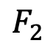
individual
Structured Population = multiple individuals of the same species (conspecifics) in the same habitat but in different life history stages
population
metapopulation
$$F_{2}$$
baby fish (x₁)
adult fish (x₂)
community
1
2
How does the abundance of fish change through time?
ecosystem

Slide 52
Modeling demographic complexity

Slide 53
Modeling demographic complexity
1. Populations are divided into compartments
2. Individuals within a compartment are homogenously mixed
3. Compartments and transition rates are
determined by biological systems
4. Rates of transferring between compartments
are expressed mathematically
births
Madagascar
(N)
deaths
The simplest
population model

Slide 54
Modeling demographic complexity
1. Populations are divided into compartments
2. Individuals within a compartment are homogenously mixed
3. Compartments and transition rates are
determined by biological systems
4. Rates of transferring between compartments
are expressed mathematically
births
Madagascar
(N)
deaths
What is wrong about this model?

Slide 55
Modeling demographic complexity
1. Populations are divided into compartments
2. Individuals within a compartment are homogenously mixed
3. Compartments and transition rates are
determined by biological systems
4. Rates of transferring between compartments
are expressed mathematically
births
Madagascar
(N)
deaths
What is wrong about this model?

Slide 56
Modeling demographic complexity
1. Populations are divided into compartments
2. Individuals within a compartment are homogenously mixed
3. Compartments and transition rates are
determined by biological systems
4. Rates of transferring between compartments
are expressed mathematically
Babies
Adults
The structured
population model

Slide 57
Modeling demographic complexity
1. Populations are divided into compartments
2. Individuals within a compartment are homogenously mixed
3. Compartments and transition rates are
determined by biological systems
4. Rates of transferring between compartments
are expressed mathematically
Babies
Adults
The structured
population model

Slide 58
Modeling demographic complexity
1. Populations are divided into compartments
2. Individuals within a compartment are homogenously mixed
3. Compartments and transition rates are
determined by biological systems
4. Rates of transferring between compartments
are expressed mathematically
births
Babies
aging
Adults
deaths
deaths
The structured
population model

Slide 59
The structured
population model
1. Populations are divided into compartments
2. Individuals within a compartment are homogenously mixed
3. Compartments and transition rates are
determined by biological systems
4. Rates of transferring between compartments
are expressed mathematically
Births (B)
Population rate of increase
Babies
aging (a)
Adults
λ=N_{t+1}/N_{t}
deaths (1-s_{b})
deaths (1-s_{a})
N_{t+1} = A* N_{t}
pop size at t
pop size at t + 1
matrix of survival and fecundity rates
vector of
population sizes
s_{b}(1-a)
B
s_{b}a
s_{a}

Slide 60
The structured
population model
1. Populations are divided into compartments
2. Individuals within a compartment are homogenously mixed
3. Compartments and transition rates are
determined by biological systems
4. Rates of transferring between compartments
are expressed mathematically
Births (B)
Population rate of increase
Babies
aging (a)
Adults
λ=N_{t+1}/N_{t}
deaths (1-s_{b})
deaths (1-s_{a})
N_{t+1} = A* N_{t}
pop size at t
pop size at t + 1
matrix of survival and fecundity rates
vector of
population sizes
s_{b}(1-a)
B
s_{b}a
s_{a}
*Discrete time

Slide 61
The structured
population model
1. Populations are divided into compartments
2. Individuals within a compartment are homogenously mixed
3. Compartments and transition rates are
determined by biological systems
4. Rates of transferring between compartments
are expressed mathematically
Births (B)
Babies
aging (a)
Adults
deaths (1-s_{b})
deaths (1-s_{a})
N_{t+1} = A* N_{t}
A
N_{t}
N_{t+1}
s_{b}(1-a)
B
N_{b}
s_{b}(1-a) N_{b} + BN_{a}
x
=
s_{b}a
s_{a}
N_{a}
s_{b} a N_{b} + s_{a}N_{a}

Slide 62
The structured
population model
1. Populations are divided into compartments
2. Individuals within a compartment are homogenously mixed
3. Compartments and transition rates are
determined by biological systems
4. Rates of transferring between compartments
are expressed mathematically
Births (B)
Babies
aging (a)
Adults
deaths (1-s_{b})
deaths (1-s_{a})
N_{t+1} = A* N_{t}
A
N_{t}
N_{t+1}
Population rate of increase
λ=dominant eigenvalue of transition matrix
s_{b}(1-a)
B
N_{b}
s_{b}(1-a) N_{b} + BN_{a}
x
=
s_{b}a
s_{a}
N_{a}
s_{b} a N_{b} + s_{a}N_{a}
Population growth will depend on population structure!
(pop grows @ λ >1 & declines @ λ < 1 )

Slide 63
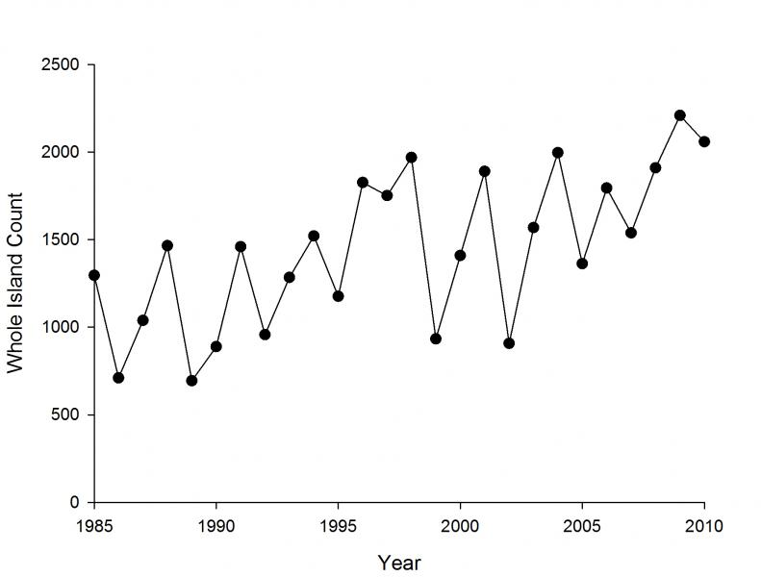
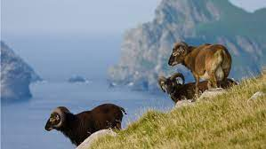
Structured populations in practice
Soay Sheep of St. Kilda, Scotland
Notes:
Since the 1980s, scientists from Cambridge have been censusing them annually and tagging every individual. They exhibit these dramatic population fluctuations

Slide 64
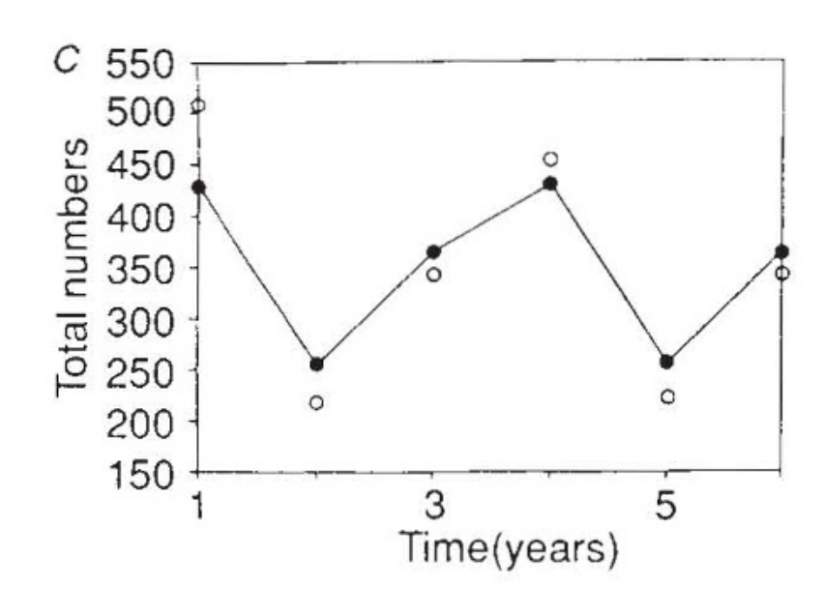
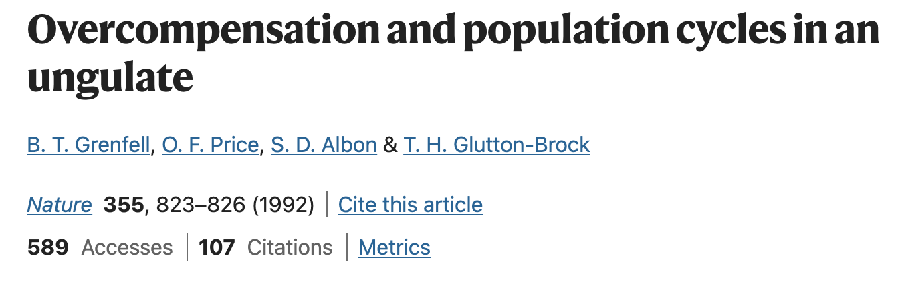
Structured populations in practice
Model compared against data
Soay Sheep of St. Kilda, Scotland
Notes:
Models used both to predict and to explain

Slide 65
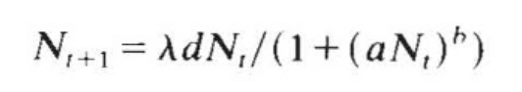
Structured populations in practice
Model compared against data
These results used a simple density-dependent model only!
a and b control the strength of density dependence.
growth rate
population at t+1
average fecundity
population at t
Notes:
Models used both to predict and to explain

Slide 66
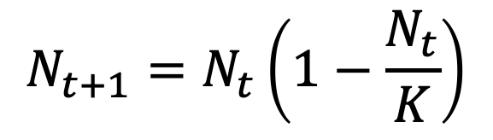
Structured populations in practice
Model compared against data
These results used a simple density-dependent model only!
a and b control the strength of density dependence.
growth rate
population at t+1
average fecundity
population at t
Similar to the simple logistic growth equation!
$$N_{t+1}=N_{t}\left(1−\frac{N_{t}}{K}\right)$$
Notes:
Models used both to predict and to explain

Slide 67
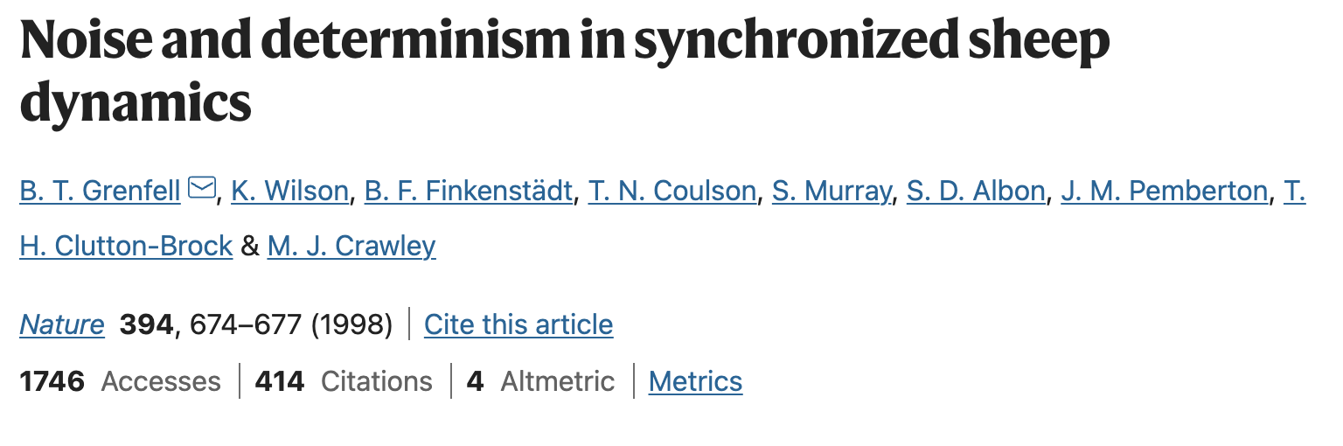
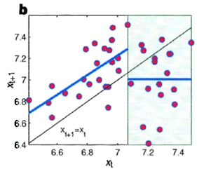
Structured populations in practice
In later work, the authors added environmental stochasticity (bad weather) to better represent the data……
Notes:
Models used both to predict and to explain

Slide 68
Structured populations in practice
In later work, the authors added environmental stochasticity (bad weather) to better represent the data……
Notes:
Models used both to predict and to explain

Slide 69
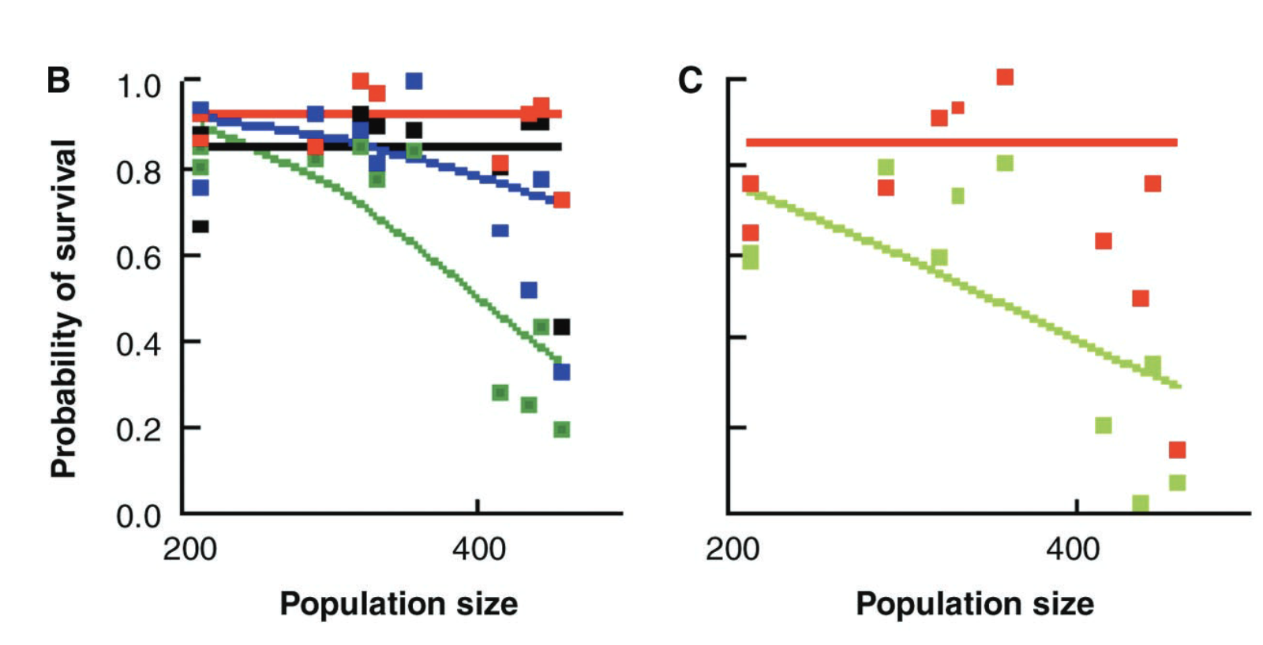
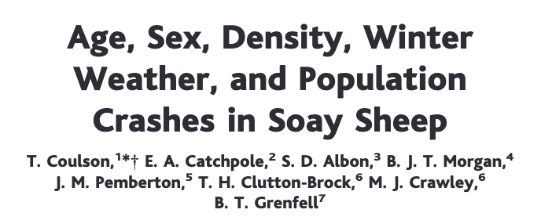

Structured populations in practice
And, finally, they added in population structure as well!
lambs
yearlings
adults
older adults
lambs
adults
Notes:
Colors

Slide 70
The structured
population model
If data are available, we can model much more detailed population structures using the same approach.
F₃
F₄
F₅
F₂
Age₁
Age₂
Age₃
Age₄
Age₅
s₁
s₂
s₃
s₄
The Leslie matrix model divides classes based on age.
The Lefkovitch matrix model divides classes based on life stage.
Leslie 1945 Biometrika. Leslie 1948 Biometrika.
Lefkovitch 1965 Biometrics.

Slide 71
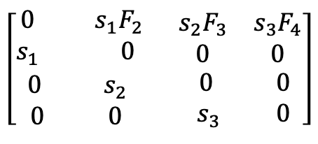
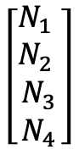
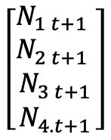
The structured
population model
If data are available, we can model much more detailed population structures using the same approach.
F₃
F₄
F₂
Age₁
Age₂
Age₃
Age₄
s₁
s₂
s₃
A
N_{t}
N_{t+1}
λ=dominant eigenvalue of transition matrix
$$\left[\begin{aligned}\begin{matrix}0 & s_{1}F_{2} \\ s_{1} & 0\end{matrix} \begin{matrix}s_{2}F_{3} & s_{3}F_{4} \\ 0 & 0\end{matrix} \\ \begin{matrix}0 & s_{2} \\ 0 & 0\end{matrix} \begin{matrix} 0 & 0 \\ .{ s}_{3} & 0\end{matrix}\end{aligned}\right]$$
$$\left[\begin{matrix}\begin{matrix}N_{1} \\ N_{2}\end{matrix} \\ \begin{matrix}N_{3} \\ N_{4}\end{matrix}\end{matrix}\right]$$
$$\left[\begin{matrix}\begin{matrix}N_{1 t+1} \\ N_{2 t+1}\end{matrix} \\ \begin{matrix}N_{3 t+1} \\ N_{4.t+1}\end{matrix}\end{matrix}\right]$$
x
=
N_{t+1} = A* N_{t}
Leslie 1945 Biometrika. Leslie 1948 Biometrika.
Lefkovitch 1965 Biometrics.

Slide 72
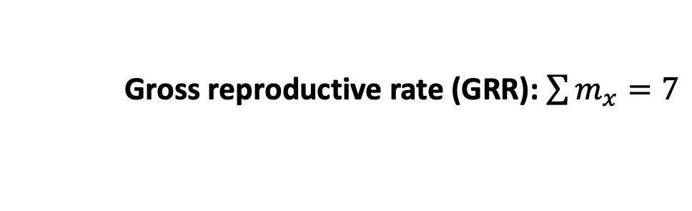
The structured
population model
F₃
F₄
F₂
Age₁
Age₂
Age₃
Age₄
Demographers collect these rates in life tables
s₁
s₂
s₃
x (age) | N_{x} (number in cohort) | l_{x} (survivorship to age x) | m_{x} (fecundity) | l_{x}m_{x}
0 | 100 | 1 | 0 | 0
1 | 60 | .6 | 2 | 1.2
2 | 30 | .3 | 3 | 0.9
3 | 10 | .1 | 1 | 0.1
4 | 1 | .01 | 1 | 0.01
x
=
Gross reproductive rate (GRR): $\sum{m_{x}=7}$

Slide 73
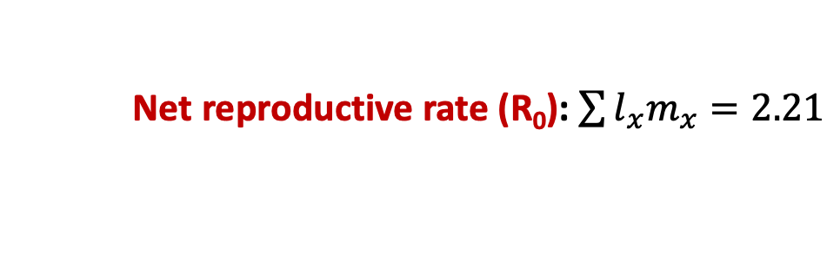
The structured
population model
F₃
F₄
F₂
Age₁
Age₂
Age₃
Age₄
Demographers collect these rates in life tables
s₁
s₂
s₃
x (age) | N_{x} (number in cohort) | l_{x} (survivorship to age x) | m_{x} (fecundity) | l_{x}m_{x}
0 | 100 | 1 | 0 | 0
1 | 60 | .6 | 2 | 1.2
2 | 30 | .3 | 3 | 0.9
3 | 10 | .1 | 1 | 0.1
4 | 1 | .01 | 1 | 0.01
x
=
Net reproductive rate (R₀): $\sum{l_{x}m_{x}=2.21}$

Slide 74
The structured
population model
F₃
F₄
F₂
Age₁
Age₂
Age₃
Age₄
Demographers collect these rates in life tables
s₁
s₂
s₃
x (age) | N_{x} (number in cohort) | l_{x} (survivorship to age x) | m_{x} (fecundity) | l_{x}m_{x}
0 | 100 | 1 | 0 | 0
1 | 60 | .6 | 2 | 1.2
2 | 30 | .3 | 3 | 0.9
3 | 10 | .1 | 1 | 0.1
4 | 1 | .01 | 1 | 0.01
x
=
Net reproductive rate (R₀): $\sum{l_{x}m_{x}=2.21}$
(pop grows at $R0$ >1 and declines at $R0$ < 1)

Slide 75
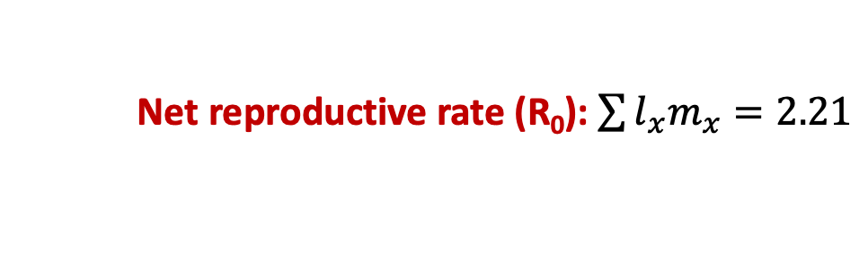
The structured
population model
F₃
F₄
F₂
Age₁
Age₂
Age₃
Age₄
Demographers collect these rates in life tables
s₁
s₂
s₃
x (age) | N_{x} (number in cohort) | l_{x} (survivorship to age x) | m_{x} (fecundity) | l_{x}m_{x}
0 | 100 | 1 | 0 | 0
1 | 60 | .6 | 2 | 1.2
2 | 30 | .3 | 3 | 0.9
3 | 10 | .1 | 1 | 0.1
4 | 1 | .01 | 1 | 0.01
x
=
Net reproductive rate (R₀): $\sum{l_{x}m_{x}=2.21}$
λ = ${R0}^{1/G}$ where G = length of a generation (often 1 year)

Slide 76
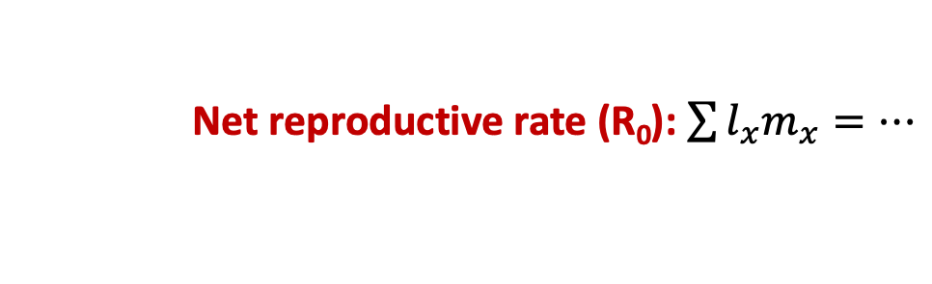
The structured
population model
F₃
F₄
F₂
Age₁
Age₂
Age₃
Age₄
s₁
s₂
s₃
x (age) | N_{x} (number in cohort) | l_{x} (survivorship to age x) | m_{x} (fecundity) | l_{x}m_{x}
0 | 100 | 1 | 0 | 0
1 | 60 | .6 | 2 | 1.2
2 | 30 | .3 | 3 | 0.9
3 | 10 | .1 | 1 | 0.1
4 | 1 | .01 | 1 | 0.01
x
=
…
Orange roughy can live up to 200 years!
Net reproductive rate (R₀): $\sum{l_{x}m_{x}=…}$

Slide 77
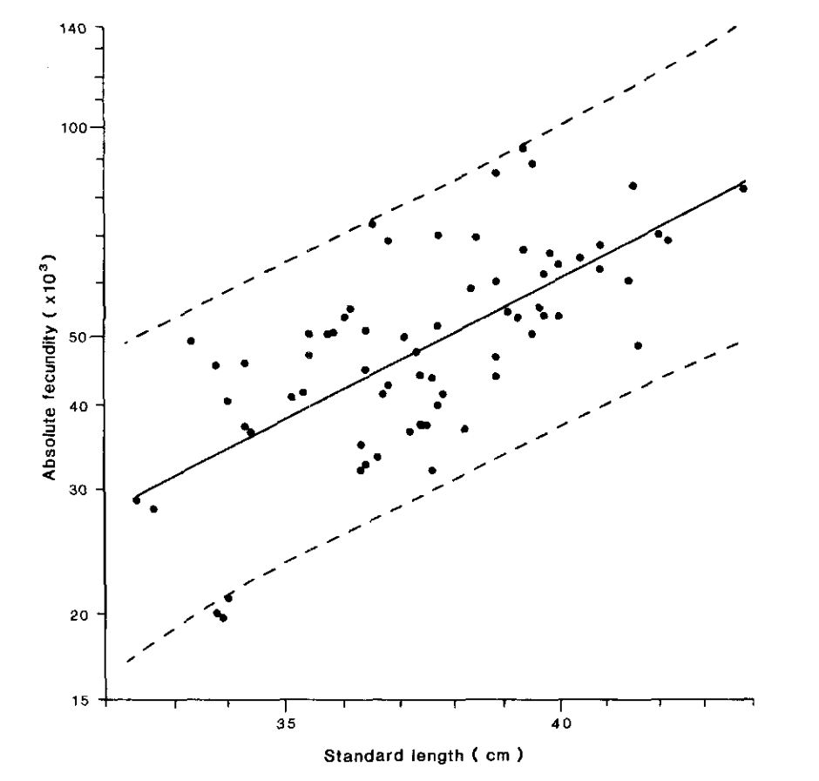

The structured
population model
F₃
F₄
F₂
Age₁
Age₂
Age₃
Age₄
s₁
s₂
s₃
Fecundity (eggs) increases in older, bigger fish!
Absolute fecundity (x10³)
Pankhurst & Conroy 1987
NZ J of Marine & Freshwater Res
Standard length (cm)
Net reproductive rate (R₀): $\sum{l_{x}m_{x}=…}$

Slide 78
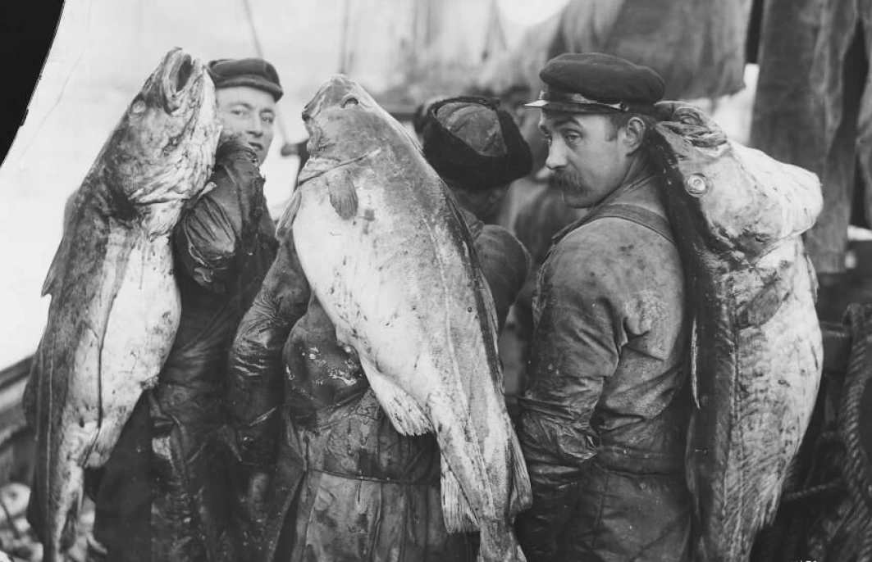
The structured
population model
F₃
F₄
F₂
Age₁
Age₂
Age₃
Age₄
s₁
s₂
s₃
Fecundity (eggs) increases in older, bigger fish!
Absolute fecundity (x10³)
These are precisely the fish we like to catch! One of the problems with MSY…
Norway 1910
(Norsk folkemuseum)
Standard length (cm)

Slide 79
The structured
population model
F₃
F₄
F₂
Age₁
Age₂
Age₃
Age₄
s₁
s₂
s₃
Poor modeling projections has led to severe overexploitation, a common problem in fisheries…
In 2008, the international TAC for orange roughy was reduced from 1470 tons to 914 tons… down from over 90,000 tons in the early 1990s…

Slide 80
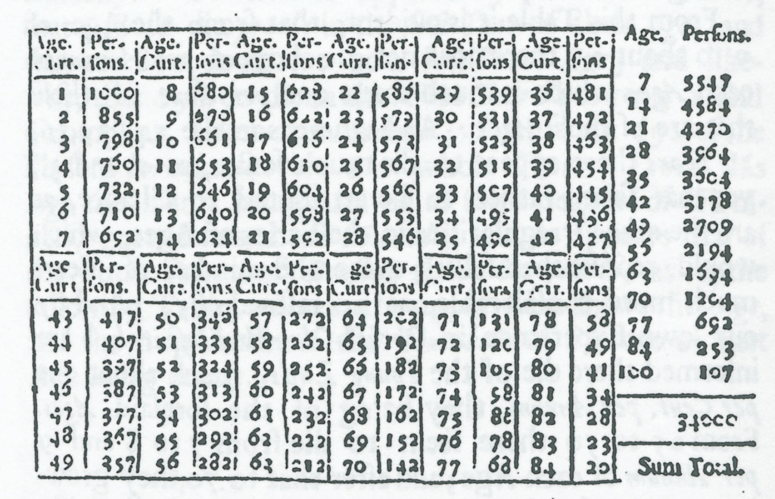
The structured
population model
F₃
F₄
F₂
Age₁
Age₂
Age₃
Age₄
Life table analysis is also used extensively in human demography.
s₁
s₂
s₃
Edmond Halley, 1693
“An estimate of the degrees of the mortality of mankind, drawn from curious tables of the births and funerals at the city of Breslau, with an attempt to ascertain the price of annuities upon lives…”
Notes:
Halley

Slide 81
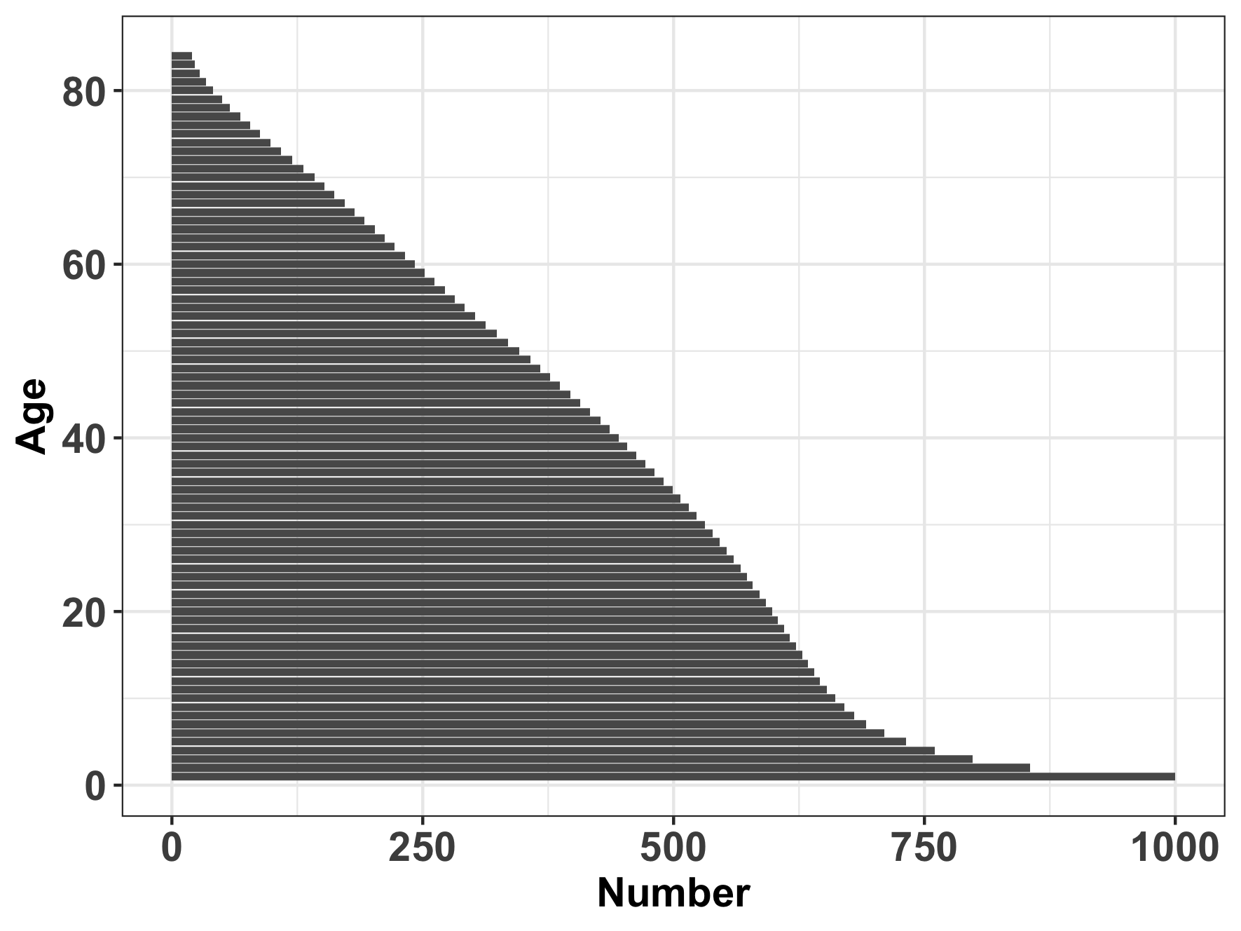
The structured
population model
F₃
F₄
F₂
Age₁
Age₂
Age₃
Age₄
Population pyramid for Breslau
s₁
s₂
s₃
Edmond Halley, 1693
“An estimate of the degrees of the mortality of mankind, drawn from curious tables of the births and funerals at the city of Breslau, with an attempt to ascertain the price of annuities upon lives…”
Notes:
Halley

Slide 82
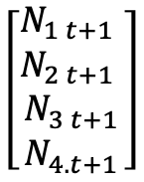

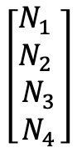
The structured
population model
F₃
F₄
F₂
Age₁
Age₂
Age₃
Age₄
Population pyramid for Breslau
s₁
s₂
s₃
Humans are not like fish!
Fecundity tends to decrease in older age classes due to reproductive senescence.
Younger human populations that start giving birth earlier grow faster!
A
N_{t}
N_{t+1}
$$\left[\begin{aligned}\begin{matrix}0 & s_{1}F_{2} \\ s_{1} & 0\end{matrix} \begin{matrix}s_{2}F_{3} & s_{3}F_{4} \\ 0 & 0\end{matrix} \\ \begin{matrix}0 & s_{2} \\ 0 & 0\end{matrix} \begin{matrix} 0 & 0 \\ .{ s}_{3} & 0\end{matrix}\end{aligned}\right]$$
$$\left[\begin{matrix}\begin{matrix}N_{1} \\ N_{2}\end{matrix} \\ \begin{matrix}N_{3} \\ N_{4}\end{matrix}\end{matrix}\right]$$
$$\left[\begin{matrix}\begin{matrix}N_{1 t+1} \\ N_{2 t+1}\end{matrix} \\ \begin{matrix}N_{3 t+1} \\ N_{4.t+1}\end{matrix}\end{matrix}\right]$$
x
=
Notes:
Halley

Slide 83
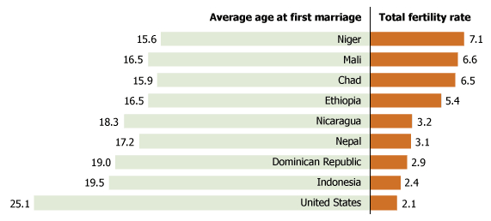
The structured
population model
F₃
F₄
F₂
Age₁
Age₂
Age₃
Age₄
s₁
s₂
s₃
Humans are not like fish!
Fecundity tends to decrease in older age classes due to reproductive senescence.
Younger human populations that start giving birth earlier grow faster!
A
N_{t}
N_{t+1}
$$\left[\begin{aligned}\begin{matrix}0 & s_{1}F_{2} \\ s_{1} & 0\end{matrix} \begin{matrix}s_{2}F_{3} & s_{3}F_{4} \\ 0 & 0\end{matrix} \\ \begin{matrix}0 & s_{2} \\ 0 & 0\end{matrix} \begin{matrix} 0 & 0 \\ .{ s}_{3} & 0\end{matrix}\end{aligned}\right]$$
$$\left[\begin{matrix}\begin{matrix}N_{1} \\ N_{2}\end{matrix} \\ \begin{matrix}N_{3} \\ N_{4}\end{matrix}\end{matrix}\right]$$
$$\left[\begin{matrix}\begin{matrix}N_{1 t+1} \\ N_{2 t+1}\end{matrix} \\ \begin{matrix}N_{3 t+1} \\ N_{4.t+1}\end{matrix}\end{matrix}\right]$$
x
=
Notes:
Total fertility rate = average number of offspring per woman

Slide 84
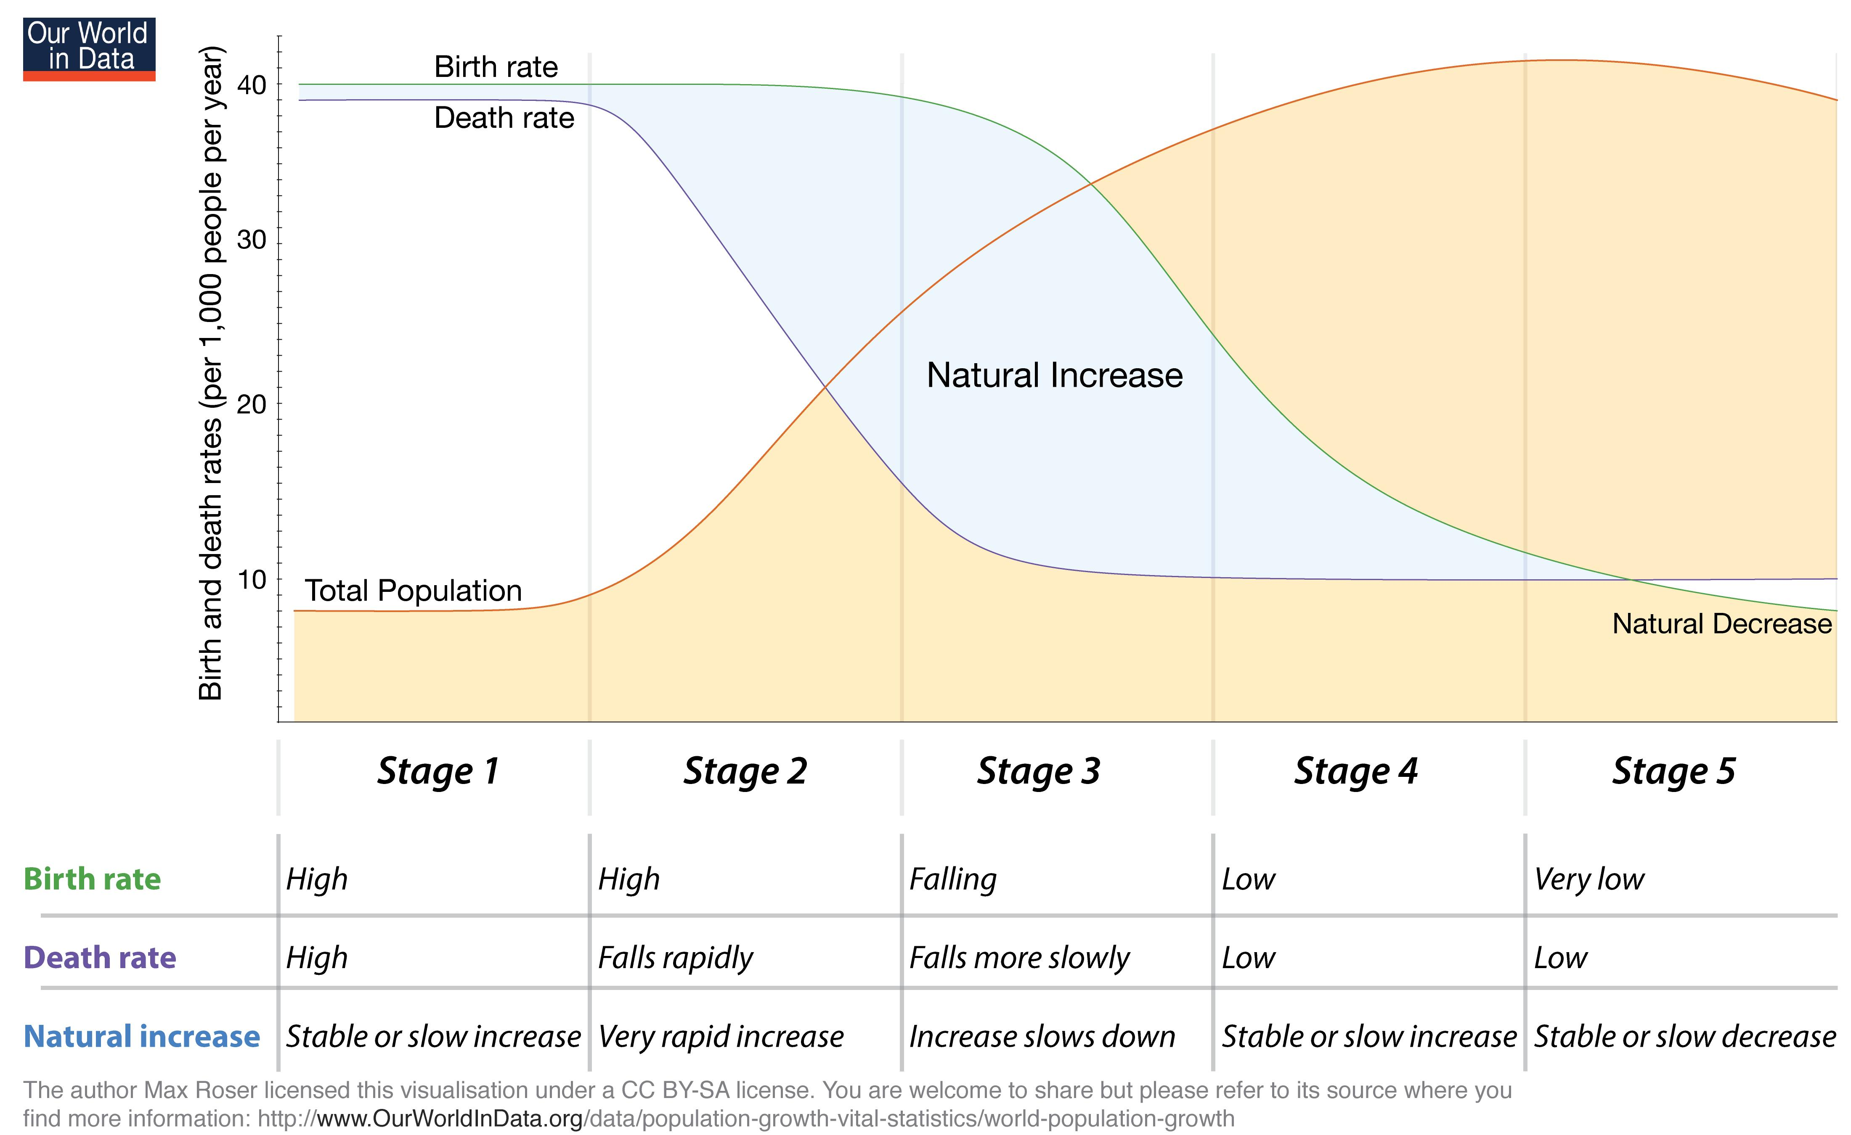
Demographic transition
Notes:
5 stages to a demographic transition – high pop growth in stage 2

Slide 85
Demographic transition
Notes:
5 stages to a demographic transition – high pop growth in stage 2

Slide 86
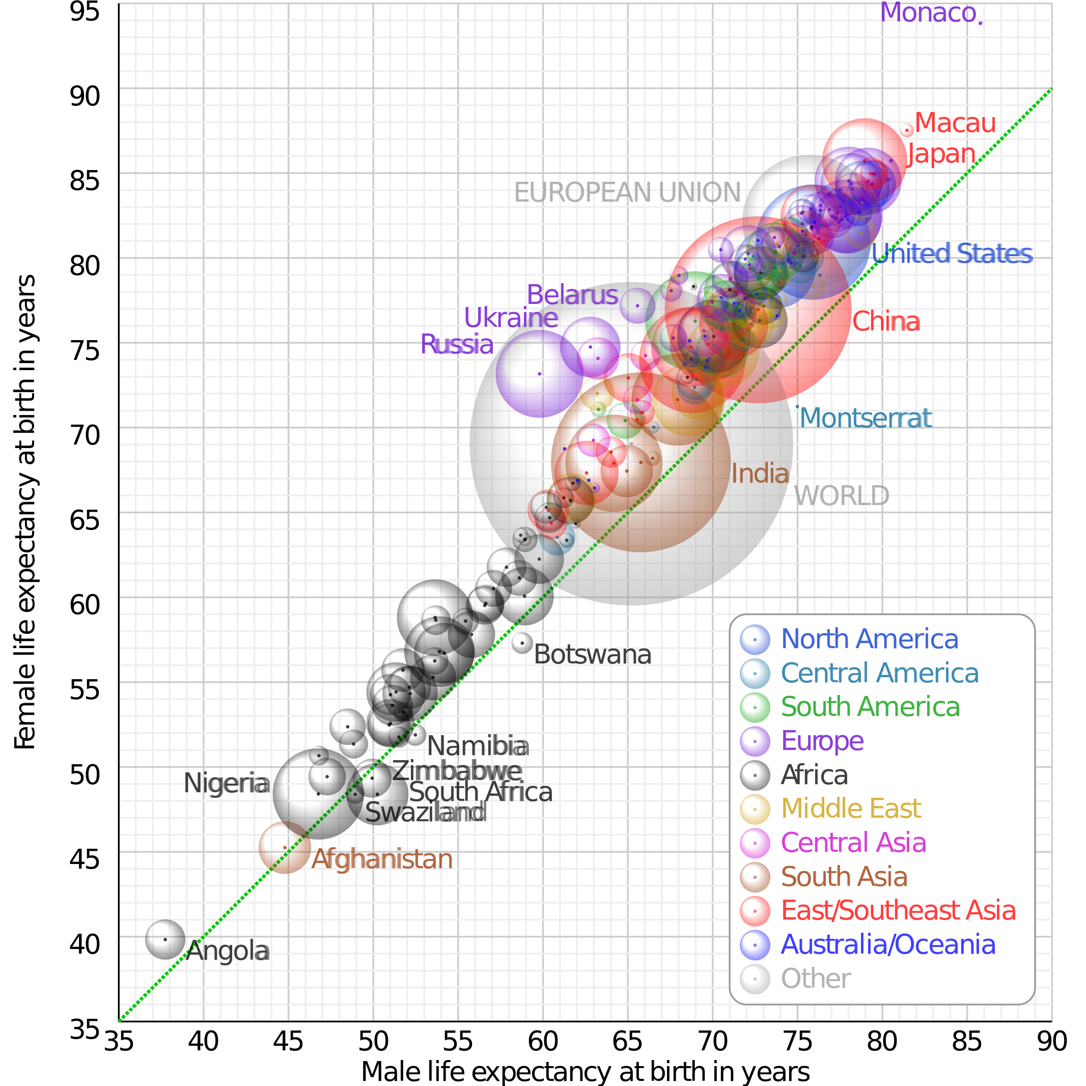
Demographic transition
Death rates are falling globally…

Slide 87
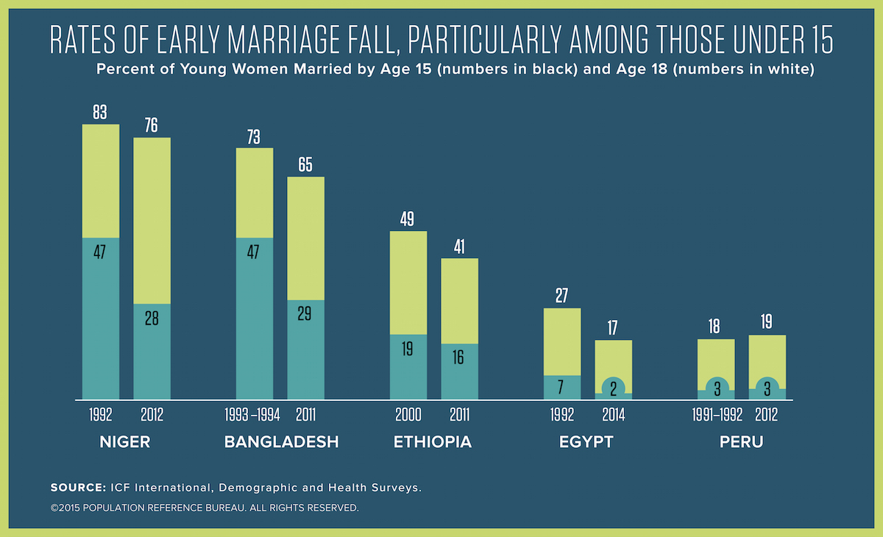
Demographic transition
And birth rates are also falling…

Slide 88
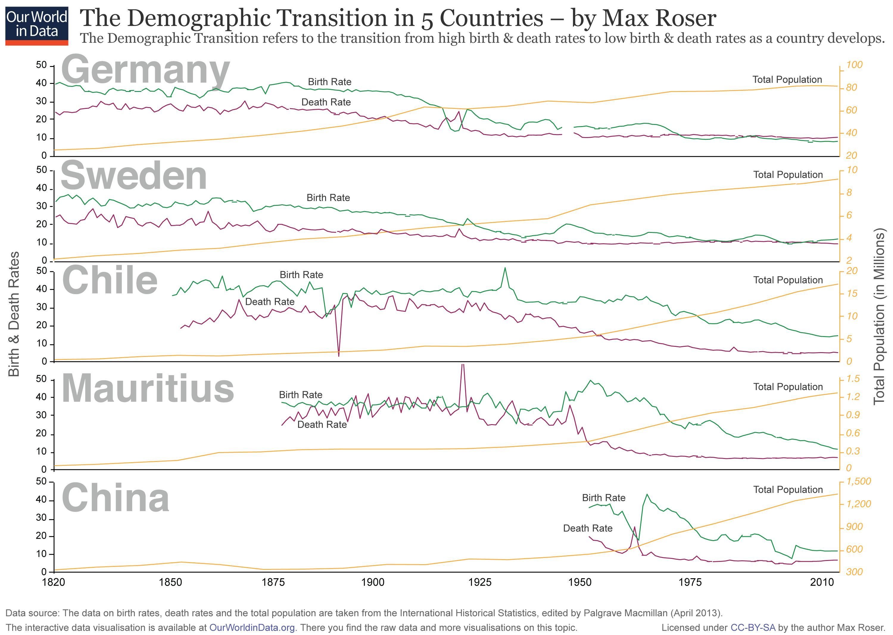
Demographic transition
Notes:
5 stages to a demographic transition – high pop growth in stage 2

Slide 89
Demographic transition
How does age structure predict population growth?
Notes:
5 stages to a demographic transition – high pop growth in stage 2

Slide 90
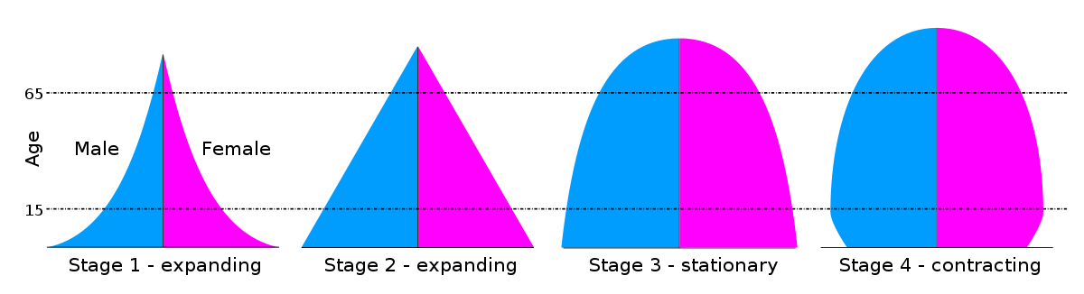
Demographic transition
How does age structure predict population growth?
Notes:
5 stages to a demographic transition – high pop growth in stage 2

Slide 91
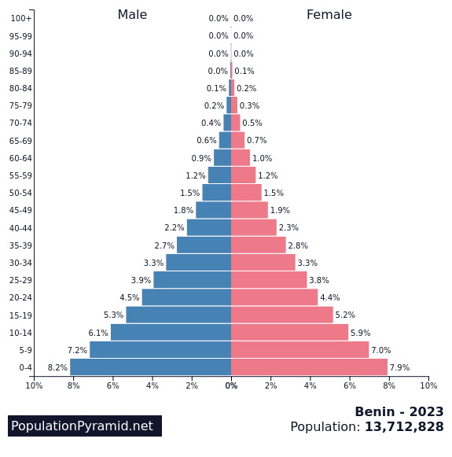

Where are we globally?
Notes:
5 stages to a demographic transition – high pop growth in stage 2

Slide 92


Where are we globally?
Notes:
Declining death rates without declining birth rates

Slide 93

Where are we globally?

Slide 94
Structured population models can be scaled up to metapopulation models, depending on the data and question at hand

Slide 95






Metapopulation = sub-populations of conspecifics connected by migration or dispersal
individual
population
1
$$d_{1}$$
fish₁
(x₁)
$$d_{2}$$
metapopulation
2
1
$$d_{6}$$
fish₂
(x₂)
community
$$d_{5}$$
$$d_{3}$$
3
2
How do the abundances of different subpopulations of the same fish vary in space [and time]?
fish₃
(x₃)
ecosystem
$$d_{4}$$
3

Slide 96
Modeling metapopulation dynamics
a “population of populations” -Richard Levins 1969

Slide 97

Modeling metapopulation dynamics
a “population of populations” -Richard Levins 1969
fraction of patches occupied at a given time
$$\frac{dp}{dt}=cp\left(1−p\right) −ep$$
colonization rate
extinction rate
proportion of unoccupied patches

Slide 98



Modeling metapopulation dynamics
a “population of populations” -Richard Levins 1969
$$\frac{dp}{dt}=cp\left(1−p\right) −ep$$
mathematically equivalent to the logistic growth equation when $r=c−e$ and $K= 1−\frac{e}{c}$
$$\frac{dN}{dt}=rN\left(1−\frac{N}{K}\right)$$
$$\frac{dN}{dt}=(c−e)N\left(1−\frac{N}{\left(1−\frac{e}{c}\right)}\right)$$

Slide 99
Modeling metapopulation dynamics
a “population of populations” -Richard Levins 1969
$$\frac{dp}{dt}=cp\left(1−p\right) −ep$$
mathematically equivalent to the logistic growth equation when $r=c−e$ and $K= 1−\frac{e}{c}$
$$\frac{dN}{dt}=rN\left(1−\frac{N}{K}\right)$$
rate of colonization increases when more patches and decreases as they become occupied
(subpopulations within Levins’ metapopulation model are unstructured)
$$\frac{dN}{dt}=(c−e)N\left(1−\frac{N}{\left(1−\frac{e}{c}\right)}\right)$$

Slide 100



Why do metapopulations matter?
Glanville fritillary butterfly
Melitaea cinxia
Saccheri et al 1998. Nature.
Notes:
All known suitable meadows are shown as small circles, with meadows in which Glanville fritillary larvae were present in autumn 1995 indicated by black circles (and large symbols), and unoccupied meadows by white circles. Of the 42 local populations sampled, the 35 that survived to autumn 1996 (green circles) are distinguished from the seven that went extinct (red triangles).

Slide 101


Why do metapopulations matter?
Saccheri et al 1998. Nature.
Hanski et al. 1996. The American Naturalist.
Notes:
he relationships betweentheobservedprobability of local extinction (EobS; vertical axis)andthecalculatedextinction probability without the rescue effect (Eint; circles) and theproduct Eint(1- C) (asterisks, whereC istheprobability of recolonization of anempty patch).NotethatEob, ' Eint(1- C), whichsuggests thatr 1 inequation(4). Theseresults arefor the Glanville fritillary, Melitaeacinxia,livingina largenetworkof habitat patches (Hanskiet al.1995a;I. Hanski,unpublished data).The broken line indicates equalityof the extinction rates

Slide 102
Why do metapopulations matter?
star points recalculated with rescue effect from Levins’ model
Saccheri et al 1998. Nature.
Hanski et al. 1996. The American Naturalist.
Notes:
he relationships betweentheobservedprobability of local extinction (EobS; vertical axis)andthecalculatedextinction probability without the rescue effect (Eint; circles) and theproduct Eint(1- C) (asterisks, whereC istheprobability of recolonization of anempty patch).NotethatEob, ' Eint(1- C), whichsuggests thatr 1 inequation(4). Theseresults arefor the Glanville fritillary, Melitaeacinxia,livingina largenetworkof habitat patches (Hanskiet al.1995a;I. Hanski,unpublished data).The broken line indicates equalityof the extinction rates

Slide 103

Structured population models and metapopulation models can be combined, depending on the data and question at hand
Dr. Christopher Golden, Harvard University
Dr. James Herrera,
Duke University
Dr. Cortni Borgerson, Montclair University
Hervet Randriamady, Harvard University
B.J. Rodolph
Rasolofoniaina, MAHERY
Dr. Emma Fuller, Fractal Agriculture

Slide 104
What are the future population trajectories for hunted lemurs on Madagascar’s Makira-Masoala peninsula?
Brook et al. 2018. Conservation Biology.
Notes:
- Makira Natural Park and Masoala National Park = Madagascar’s largest protected area and one of the last remaining tracts of intact rainforest.
home to > 50% of the island’s floral biodiversity
And highest lemur diversity known on the island (17 spp total)

Slide 105
What are the future population trajectories for hunted lemurs on Madagascar’s Makira-Masoala peninsula?
103 extant species of lemur
Brook et al. 2018. Conservation Biology.
Notes:
- Makira Natural Park and Masoala National Park = Madagascar’s largest protected area and one of the last remaining tracts of intact rainforest.
home to > 50% of the island’s floral biodiversity
And highest lemur diversity known on the island (17 spp total)

Slide 106
What are the future population trajectories for hunted lemurs on Madagascar’s Makira-Masoala peninsula?
103 extant species of lemur
94% under some IUCN category of threat
24 Critically Endangered
49 Endangered
20 Vulnerable
3 Near Threatened
3 Least Concern
4 Data Deficient
The most imperiled group of mammals on earth
Brook et al. 2018. Conservation Biology.
Notes:
- Makira Natural Park and Masoala National Park = Madagascar’s largest protected area and one of the last remaining tracts of intact rainforest.
home to > 50% of the island’s floral biodiversity
And highest lemur diversity known on the island (17 spp total)

Slide 107
What are the future population trajectories for hunted lemurs on Madagascar’s Makira-Masoala peninsula?
103 extant species of lemur
94% under some IUCN category of threat
The most imperiled group of mammals on earth
Aimed to highlight what quantitative population viability analysis can add to conservation management and pinpoint data gaps
Brook et al. 2018. Conservation Biology.
Notes:
- Makira Natural Park and Masoala National Park = Madagascar’s largest protected area and one of the last remaining tracts of intact rainforest.
home to > 50% of the island’s floral biodiversity
And highest lemur diversity known on the island (17 spp total)

Slide 108
What are the future population trajectories for hunted lemurs on Madagascar’s Makira-Masoala peninsula?
103 extant species of lemur
94% under some IUCN category of threat
The most imperiled group of mammals on earth
Aimed to highlight what quantitative population viability analysis can add to conservation management and pinpoint data gaps
We collected seasonal human household consumption and hunter offtake data from 1155 households in 52 villages on the Makira-Masoala peninsula
Brook et al. 2018. Conservation Biology.
Notes:
- Makira Natural Park and Masoala National Park = Madagascar’s largest protected area and one of the last remaining tracts of intact rainforest.
home to > 50% of the island’s floral biodiversity
And highest lemur diversity known on the island (17 spp total)

Slide 109
What are the future population trajectories for hunted lemurs on Madagascar’s Makira-Masoala peninsula?
103 extant species of lemur
94% under some IUCN category of threat
The most imperiled group of mammals on earth
Aimed to highlight what quantitative population viability analysis can add to conservation management and pinpoint data gaps
We collected seasonal human household consumption and hunter offtake data from 1155 households in 52 villages on the Makira-Masoala peninsula
MAHERY conducted monthly dietary recall interviews for target taxa in households from 2005-2013
Brook et al. 2018. Conservation Biology.
Notes:
- Makira Natural Park and Masoala National Park = Madagascar’s largest protected area and one of the last remaining tracts of intact rainforest.
home to > 50% of the island’s floral biodiversity
And highest lemur diversity known on the island (17 spp total)

Slide 110
What are the future population trajectories for hunted lemurs on Madagascar’s Makira-Masoala peninsula?
103 extant species of lemur
94% under some IUCN category of threat
The most imperiled group of mammals on earth
Aimed to highlight what quantitative population viability analysis can add to conservation management and pinpoint data gaps
We collected seasonal human household consumption and hunter offtake data from 1155 households in 52 villages on the Makira-Masoala peninsula
MAHERY conducted monthly dietary recall interviews for target taxa in households from 2005-2013
Local hunters from one village outfitted with diaries to record harvested species
Brook et al. 2018. Conservation Biology.
Notes:
- Makira Natural Park and Masoala National Park = Madagascar’s largest protected area and one of the last remaining tracts of intact rainforest.
home to > 50% of the island’s floral biodiversity
And highest lemur diversity known on the island (17 spp total)

Slide 111
- 8
- 4
- 0
- 8
- 4
- 0
- 8
- 4
- 0
- 8
- 4
- 0
- 8
- 4
- 0
Monthly offtake per household/hunter
- 8
- 4
- 0
- 8
- 4
- 0
- 8
- 4
- 0
- 8
- 4
- 0
- 8
- 4
- 0
- 8
- 4
- 0
Brook et al. 2018. Conservation Biology.
Notes:
I show here the seasonality of lemur hunt and consumption through generalized additive models fitted to household (in red) and individual hunter (in yellow) offtake by month of the year, with a random effect of year across the 8 years of survey
We can see the slight monthly timelag between hunting and consumption as the difference in yellow versus red line
A key takeaway is that the majority of hunting occurs during the hot wet season between March and June in Makira-Masoala when frugivorous lemurs are easiest to trap as they exploit fruit resources.
﻿Data were derived from interviews conducted in 1155 unique households distributed among 52 Makira villages from 2005 to 2013 and
Diaries of 18 unique wildlife hunters from 1 Makira village in which hunters recorded daily species-specific catch for a subset of months from 2006 to 2011
﻿In household interviews, respondents identified the quantity of each species consumed within the month preceding questioning. Respondents were queried directly, by name, about 29 species. We analyzed responses concerning 11 lemur species
﻿In hunter diaries, hunters recorded the number of a given species caught each day. Hunters reported catches of 25 wildlife species, including 7 of the above 11 lemurs
﻿To determine whether annual lemur offtake varied
across the study duration (2005–2013),we fit generalized linear mixed effects regression models with Poisson and zero-inflated Poisson (ZIP) distributions to the response variable for both data sets: monthly household lemur offtake. We modeled the continuous variable of year as a fixed predictor and included random effects of species, month, and household-nested-within village or hunter for the 2 data sources (Supporting Information). The data set contained an excess of zeros, which typically demands treatment as a ZIP process. Zero-inflated Poisson models consider the response variable as a mixture of both a Bernoulli process, which yields the 0–1 probability of recovering a positive count, and a Poisson process, which delineates positive or negative trends in that count.
We hypothesized that an increased frequency of zeros through time arises equally from declining lemur abundance or declining hunting effort.
﻿Ifmore frequent zeros were attributable to declining lemur abundance, we predicted a Poisson model would produce a negative slope and a ZIP model a positive slope when fit to the same data. That is, zeros would increase in frequency as species were extirpated, but hunting of extant species would intensify in compensation.
Conversely, if zeros were attributable to declining hunting effort, we hypothesized that both models would yield complementary negative slopeswhen fit to the samedata
﻿We examined how species-specific lemur offtake
varied by village in Makira. We aimed to produce estimates of the average monthly offtake per species per village and then to apply these estimates as hunting penalties in subsequent simulations of local extinc- tion vulnerability and density-dependent population trajectories for hunted lemurs. Because all 18 hunter diaries were derived from the same village, offering no spatial variation, we addressed this aim with only the household dataset
﻿We fit a generalized linear mixed effects regression model to the response variable of household-level monthly consumption and modeled species (a factor) as a fixed effect with random effects of month-nested-within-year and village (Supporting Information). Because our time trend analyses suggested that lemur offtake was driven by local lemur abundance (one process), we modeled village-level hunt predictions in the conventional Poisson distribution, and then used R’s predict() function to estimate average monthly offtake by species by village from our fitted model
﻿n the household data set, the best fit model retained a significant smoothing parameter (indicating hunt seasonality) for 9 of 11 species (D. madagascarien- sis and V. rubra were dropped).

Slide 112
- 8
- 4
- 0
- 8
- 4
- 0
- 8
- 4
- 0
- 8
- 4
- 0
- 8
- 4
Lemurs are primarily hunted and consumed in the hot wet season.
Most spp. birth in the cool dry season, offset from the hunt.
For Indri & Aye-Aye, peak hunt overlaps the birth pulse.
- 0
Monthly offtake per household/hunter
- 8
- 4
- 0
- 8
- 4
- 0
- 8
- 4
- 0
- 8
- 4
- 0
- 8
- 4
- 0
- 8
- 4
- 0
Brook et al. 2018. Conservation Biology.
Notes:
I show here the seasonality of lemur hunt and consumption through generalized additive models fitted to household (in red) and individual hunter (in yellow) offtake by month of the year, with a random effect of year across the 8 years of survey
We can see the slight monthly timelag between hunting and consumption as the difference in yellow versus red line
A key takeaway is that the majority of hunting occurs during the hot wet season between March and June in Makira-Masoala when frugivorous lemurs are easiest to trap as they exploit fruit resources.
﻿Data were derived from interviews conducted in 1155 unique households distributed among 52 Makira villages from 2005 to 2013 and
Diaries of 18 unique wildlife hunters from 1 Makira village in which hunters recorded daily species-specific catch for a subset of months from 2006 to 2011
﻿In household interviews, respondents identified the quantity of each species consumed within the month preceding questioning. Respondents were queried directly, by name, about 29 species. We analyzed responses concerning 11 lemur species
﻿In hunter diaries, hunters recorded the number of a given species caught each day. Hunters reported catches of 25 wildlife species, including 7 of the above 11 lemurs
﻿To determine whether annual lemur offtake varied
across the study duration (2005–2013),we fit generalized linear mixed effects regression models with Poisson and zero-inflated Poisson (ZIP) distributions to the response variable for both data sets: monthly household lemur offtake. We modeled the continuous variable of year as a fixed predictor and included random effects of species, month, and household-nested-within village or hunter for the 2 data sources (Supporting Information). The data set contained an excess of zeros, which typically demands treatment as a ZIP process. Zero-inflated Poisson models consider the response variable as a mixture of both a Bernoulli process, which yields the 0–1 probability of recovering a positive count, and a Poisson process, which delineates positive or negative trends in that count.
We hypothesized that an increased frequency of zeros through time arises equally from declining lemur abundance or declining hunting effort.
﻿Ifmore frequent zeros were attributable to declining lemur abundance, we predicted a Poisson model would produce a negative slope and a ZIP model a positive slope when fit to the same data. That is, zeros would increase in frequency as species were extirpated, but hunting of extant species would intensify in compensation.
Conversely, if zeros were attributable to declining hunting effort, we hypothesized that both models would yield complementary negative slopeswhen fit to the samedata
﻿We examined how species-specific lemur offtake
varied by village in Makira. We aimed to produce estimates of the average monthly offtake per species per village and then to apply these estimates as hunting penalties in subsequent simulations of local extinc- tion vulnerability and density-dependent population trajectories for hunted lemurs. Because all 18 hunter diaries were derived from the same village, offering no spatial variation, we addressed this aim with only the household dataset
﻿We fit a generalized linear mixed effects regression model to the response variable of household-level monthly consumption and modeled species (a factor) as a fixed effect with random effects of month-nested-within-year and village (Supporting Information). Because our time trend analyses suggested that lemur offtake was driven by local lemur abundance (one process), we modeled village-level hunt predictions in the conventional Poisson distribution, and then used R’s predict() function to estimate average monthly offtake by species by village from our fitted model
﻿n the household data set, the best fit model retained a significant smoothing parameter (indicating hunt seasonality) for 9 of 11 species (D. madagascarien- sis and V. rubra were dropped).

Slide 113
.8 -
- 8
.4 -
- 4
0 -
- 0
.8 -
- 8
.4 -
- 4
0 -
- 0
.8 -
- 8
.4 -
- 4
0 -
- 0
.8 -
- 8
.4 -
- 4
0 -
- 0
.8 -
- 8
.4 -
- 4
Lemurs are primarily hunted and consumed in the hot wet season.
Most spp. birth in the cool dry season, offset from the hunt.
For Indri & Aye-Aye, peak hunt overlaps the birth pulse.
0 -
- 0
Monthly offtake per household/hunter
.8 -
- 8
.4 -
- 4
Monthly offtake per household
0 -
- 0
Proportion of birth pulse
- 8
.8 -
.4 -
- 4
0 -
- 0
.8 -
- 8
.4 -
- 4
0 -
- 0
.8 -
- 8
.4 -
- 4
0 -
- 0
.8 -
- 8
.4 -
- 4
0 -
- 0
.8 -
- 8
.4 -
- 4
0 -
- 0
Brook et al. 2018. Conservation Biology.
Notes:
I show here the seasonality of lemur hunt and consumption through generalized additive models fitted to household (in red) and individual hunter (in yellow) offtake by month of the year, with a random effect of year across the 8 years of survey
We can see the slight monthly timelag between hunting and consumption as the difference in yellow versus red line
A key takeaway is that the majority of hunting occurs during the hot wet season between March and June in Makira-Masoala when frugivorous lemurs are easiest to trap as they exploit fruit resources.
﻿Data were derived from interviews conducted in 1155 unique households distributed among 52 Makira villages from 2005 to 2013 and
Diaries of 18 unique wildlife hunters from 1 Makira village in which hunters recorded daily species-specific catch for a subset of months from 2006 to 2011
﻿In household interviews, respondents identified the quantity of each species consumed within the month preceding questioning. Respondents were queried directly, by name, about 29 species. We analyzed responses concerning 11 lemur species
﻿In hunter diaries, hunters recorded the number of a given species caught each day. Hunters reported catches of 25 wildlife species, including 7 of the above 11 lemurs
﻿To determine whether annual lemur offtake varied
across the study duration (2005–2013),we fit generalized linear mixed effects regression models with Poisson and zero-inflated Poisson (ZIP) distributions to the response variable for both data sets: monthly household lemur offtake. We modeled the continuous variable of year as a fixed predictor and included random effects of species, month, and household-nested-within village or hunter for the 2 data sources (Supporting Information). The data set contained an excess of zeros, which typically demands treatment as a ZIP process. Zero-inflated Poisson models consider the response variable as a mixture of both a Bernoulli process, which yields the 0–1 probability of recovering a positive count, and a Poisson process, which delineates positive or negative trends in that count.
We hypothesized that an increased frequency of zeros through time arises equally from declining lemur abundance or declining hunting effort.
﻿Ifmore frequent zeros were attributable to declining lemur abundance, we predicted a Poisson model would produce a negative slope and a ZIP model a positive slope when fit to the same data. That is, zeros would increase in frequency as species were extirpated, but hunting of extant species would intensify in compensation.
Conversely, if zeros were attributable to declining hunting effort, we hypothesized that both models would yield complementary negative slopeswhen fit to the samedata
﻿We examined how species-specific lemur offtake
varied by village in Makira. We aimed to produce estimates of the average monthly offtake per species per village and then to apply these estimates as hunting penalties in subsequent simulations of local extinc- tion vulnerability and density-dependent population trajectories for hunted lemurs. Because all 18 hunter diaries were derived from the same village, offering no spatial variation, we addressed this aim with only the household dataset
﻿We fit a generalized linear mixed effects regression model to the response variable of household-level monthly consumption and modeled species (a factor) as a fixed effect with random effects of month-nested-within-year and village (Supporting Information). Because our time trend analyses suggested that lemur offtake was driven by local lemur abundance (one process), we modeled village-level hunt predictions in the conventional Poisson distribution, and then used R’s predict() function to estimate average monthly offtake by species by village from our fitted model
﻿n the household data set, the best fit model retained a significant smoothing parameter (indicating hunt seasonality) for 9 of 11 species (D. madagascarien- sis and V. rubra were dropped).

Slide 114
.8 -
- 8
.4 -
- 4
0 -
- 0
.8 -
- 8
.4 -
- 4
0 -
- 0
.8 -
- 8
.4 -
- 4
0 -
- 0
.8 -
- 8
.4 -
- 4
0 -
- 0
.8 -
- 8
.4 -
- 4
Lemurs are primarily hunted and consumed in the hot wet season.
Most spp. birth in the cool dry season, offset from the hunt.
For Indri & Aye-Aye, peak hunt overlaps the birth pulse.
0 -
- 0
Monthly offtake per household/hunter
.8 -
- 8
.4 -
- 4
Monthly offtake per household
0 -
- 0
Proportion of birth pulse
- 8
.8 -
.4 -
- 4
0 -
- 0
.8 -
- 8
.4 -
- 4
0 -
- 0
.8 -
- 8
.4 -
- 4
0 -
- 0
.8 -
- 8
.4 -
- 4
0 -
- 0
.8 -
- 8
.4 -
- 4
0 -
- 0
Brook et al. 2018. Conservation Biology.
Notes:
I show here the seasonality of lemur hunt and consumption through generalized additive models fitted to household (in red) and individual hunter (in yellow) offtake by month of the year, with a random effect of year across the 8 years of survey
We can see the slight monthly timelag between hunting and consumption as the difference in yellow versus red line
A key takeaway is that the majority of hunting occurs during the hot wet season between March and June in Makira-Masoala when frugivorous lemurs are easiest to trap as they exploit fruit resources.
﻿Data were derived from interviews conducted in 1155 unique households distributed among 52 Makira villages from 2005 to 2013 and
Diaries of 18 unique wildlife hunters from 1 Makira village in which hunters recorded daily species-specific catch for a subset of months from 2006 to 2011
﻿In household interviews, respondents identified the quantity of each species consumed within the month preceding questioning. Respondents were queried directly, by name, about 29 species. We analyzed responses concerning 11 lemur species
﻿In hunter diaries, hunters recorded the number of a given species caught each day. Hunters reported catches of 25 wildlife species, including 7 of the above 11 lemurs
﻿To determine whether annual lemur offtake varied
across the study duration (2005–2013),we fit generalized linear mixed effects regression models with Poisson and zero-inflated Poisson (ZIP) distributions to the response variable for both data sets: monthly household lemur offtake. We modeled the continuous variable of year as a fixed predictor and included random effects of species, month, and household-nested-within village or hunter for the 2 data sources (Supporting Information). The data set contained an excess of zeros, which typically demands treatment as a ZIP process. Zero-inflated Poisson models consider the response variable as a mixture of both a Bernoulli process, which yields the 0–1 probability of recovering a positive count, and a Poisson process, which delineates positive or negative trends in that count.
We hypothesized that an increased frequency of zeros through time arises equally from declining lemur abundance or declining hunting effort.
﻿Ifmore frequent zeros were attributable to declining lemur abundance, we predicted a Poisson model would produce a negative slope and a ZIP model a positive slope when fit to the same data. That is, zeros would increase in frequency as species were extirpated, but hunting of extant species would intensify in compensation.
Conversely, if zeros were attributable to declining hunting effort, we hypothesized that both models would yield complementary negative slopeswhen fit to the samedata
﻿We examined how species-specific lemur offtake
varied by village in Makira. We aimed to produce estimates of the average monthly offtake per species per village and then to apply these estimates as hunting penalties in subsequent simulations of local extinc- tion vulnerability and density-dependent population trajectories for hunted lemurs. Because all 18 hunter diaries were derived from the same village, offering no spatial variation, we addressed this aim with only the household dataset
﻿We fit a generalized linear mixed effects regression model to the response variable of household-level monthly consumption and modeled species (a factor) as a fixed effect with random effects of month-nested-within-year and village (Supporting Information). Because our time trend analyses suggested that lemur offtake was driven by local lemur abundance (one process), we modeled village-level hunt predictions in the conventional Poisson distribution, and then used R’s predict() function to estimate average monthly offtake by species by village from our fitted model
﻿n the household data set, the best fit model retained a significant smoothing parameter (indicating hunt seasonality) for 9 of 11 species (D. madagascarien- sis and V. rubra were dropped).

Slide 115
We next used a Lefkovitch matrix approach to explore the limits of population persistence for each lemur species.
Brook et al. 2018. Conservation Biology.
Leslie 1945 Biometrika. Leslie 1948 Biometrika.
Lefkovitch 1965 Biometrics.
Notes:
Say something about IBI = interbirth interval. Microcebus = IBI ; age 1st rep = 1;
E. albifrons = IBI 1.5; age 1st rep = 2.5;
Indri IBI = 2.5; age 1st rep = 7.5

Slide 116
We next used a Lefkovitch matrix approach to explore the limits of population persistence for each lemur species.
births
(F_{A})
Juveniles
Adults
juvenile survival
& aging
(s_{J})
adult
survival
(s_{A})
Assumptions:
Time-steps in units of Interbirth Intervals (IBI)
Model only females
Stable age structure
F_{A} parameters derived from the literature
Brook et al. 2018. Conservation Biology.
Leslie 1945 Biometrika. Leslie 1948 Biometrika.
Lefkovitch 1965 Biometrics.
Notes:
Say something about IBI = interbirth interval. Microcebus = IBI ; age 1st rep = 1;
E. albifrons = IBI 1.5; age 1st rep = 2.5;
Indri IBI = 2.5; age 1st rep = 7.5

Slide 117


We next used a Lefkovitch matrix approach to explore the limits of population persistence for each lemur species.
N = population vector
A = transition matrix
Nt+1
A
Nt
(where:
S_{J} = juvenile IBI survival
S_{A} = adult IBI survival
F_{A} = adult IBI fecundity)
We can explore the
zero-growth isocline of $λ$ = 1
for differing values of s_{J}, s_{A}, and F_{A}.
Brook et al. 2018. Conservation Biology.
Leslie 1945 Biometrika. Leslie 1948 Biometrika.
Lefkovitch 1965 Biometrics.

Slide 118
We plotted zero-growth isoclines to evaluate lemur population trajectories across different mortality rates.
juvenile mortality rate per IBI
Brook et al. 2018. Conservation Biology.
adult mortality rate per IBI
Notes:
Two different isoclines correspond to different combinations of demographic parameters – for instance Microcebus sometimes gives birth to 2 offspring per year and sometimes 3.
Indri sometimes have age at 1st rep at 6 – but sometimes at 9

Slide 119
3 offspring / IBI
juvenile mortality rate per IBI
Brook et al. 2018. Conservation Biology.
adult mortality rate per IBI
Notes:
Two different isoclines correspond to different combinations of demographic parameters – for instance Microcebus sometimes gives birth to 2 offspring per year and sometimes 3.
Indri sometimes have age at 1st rep at 6 – but sometimes at 9

Slide 120
2 offspring / IBI
juvenile mortality rate per IBI
Brook et al. 2018. Conservation Biology.
adult mortality rate per IBI
Notes:
Two different isoclines correspond to different combinations of demographic parameters – for instance Microcebus sometimes gives birth to 2 offspring per year and sometimes 3.
Indri sometimes have age at 1st rep at 6 – but sometimes at 9

Slide 121
juvenile mortality rate per IBI
Age @ 1st rep = 6
Brook et al. 2018. Conservation Biology.
adult mortality rate per IBI
Notes:
Two different isoclines correspond to different combinations of demographic parameters – for instance Microcebus sometimes gives birth to 2 offspring per year and sometimes 3.
Indri sometimes have age at 1st rep at 6 – but sometimes at 9

Slide 122
juvenile mortality rate per IBI
Age @ 1st rep = 9
Brook et al. 2018. Conservation Biology.
Notes:
Two different isoclines correspond to different combinations of demographic parameters – for instance Microcebus sometimes gives birth to 2 offspring per year and sometimes 3.
Indri sometimes have age at 1st rep at 6 – but sometimes at 9

Slide 123
We plotted zero-growth isoclines to evaluate lemur population trajectories across different mortality rates.
Lemurs with faster life histories are resilient to mortality.
juvenile mortality rate per IBI
Brook et al. 2018. Conservation Biology.
Notes:
Say something about IBI = interbirth interval.
Microcebus = IBI ; age 1st rep = 1; litter size 2-3
E. albifrons = IBI 1.5; age 1st rep = 2.5;
Indri IBI = 2.5; age 1st rep = 7.5

Slide 124
We plotted zero-growth isoclines to evaluate lemur population trajectories across different mortality rates.
Lemurs with faster life histories are resilient to mortality.
juvenile mortality rate per IBI
Lemurs with slower life histories are particularly vulnerable.
Brook et al. 2018. Conservation Biology.
Notes:
Say something about IBI = interbirth interval.
Microcebus = IBI = 1; age 1st rep = 1; litter size 2-3
Cheriogaleus = IBI = 1; age 1st rep = 1; litter size 2
Daubentonia IBI = 2; age 1st rep = 2-4; litter size = 1
Indri IBI = 3; age 1st rep = 6-9; litter size = 1

Slide 125
We paired household consumption data with lemur densities for 7 species at 7 sites to estimate hunt-based mortality rates and assess harvest sustainability.
Brook et al. 2018. Conservation Biology.
Notes:
Say something about IBI = interbirth interval. Microcebus = IBI ; age 1st rep = 1;
E. albifrons = IBI 1.5; age 1st rep = 2.5;
Indri IBI = 2.5; age 1st rep = 7.5

Slide 126
We paired household consumption data with lemur densities for 7 species at 7 sites to estimate hunt-based mortality rates and assess harvest sustainability.
Brook et al. 2018. Conservation Biology.
Notes:
Say something about IBI = interbirth interval. Microcebus = IBI ; age 1st rep = 1;
E. albifrons = IBI 1.5; age 1st rep = 2.5;
Indri IBI = 2.5; age 1st rep = 7.5

Slide 127
Small-bodied lemurs are largely harvested at sustainable rates on the Makira-Masoala peninsula.
Brook et al. 2018. Conservation Biology.
Notes:
Say something about IBI = interbirth interval. Microcebus = IBI ; age 1st rep = 1;
E. albifrons = IBI 1.5; age 1st rep = 2.5;
Indri IBI = 2.5; age 1st rep = 7.5

Slide 128
By contrast, larger-bodied lemurs are severely threatened.
Brook et al. 2018. Conservation Biology.
Notes:
Say something about IBI = interbirth interval. Microcebus = IBI ; age 1st rep = 1;
E. albifrons = IBI 1.5; age 1st rep = 2.5;
Indri IBI = 2.5; age 1st rep = 7.5

Slide 129
Natural background mortality and Allee effects may exacerbate threats to extirpation.
juvenile mortality rate per IBI
Brook et al. 2018. Conservation Biology.
adult mortality rate per IBI
Notes:
Say something about IBI = interbirth interval. Microcebus = IBI ; age 1st rep = 1;
E. albifrons = IBI 1.5; age 1st rep = 2.5;
Indri IBI = 2.5; age 1st rep = 7.5

Slide 130

Natural background mortality and Allee effects may exacerbate threats to extirpation.
The ‘Allee effect’ describes the correlation between population size and population ‘fitness’, often measured by the population rate of increase, $λ.$
We will revisit this!
juvenile mortality rate per IBI
Brook et al. 2018. Conservation Biology.
adult mortality rate per IBI
Notes:
Say something about IBI = interbirth interval. Microcebus = IBI ; age 1st rep = 1;
E. albifrons = IBI 1.5; age 1st rep = 2.5;
Indri IBI = 2.5; age 1st rep = 7.5

Slide 131
Finally, we built a regional metapopulation model to simulate population dynamics into the future.
Brook et al. 2018. Conservation Biology.
Notes:
﻿

Slide 132
Finally, we built a regional metapopulation model to simulate population dynamics into the future.
Assumptions:
Starting population of 200 lemurs per site
Brook et al. 2018. Conservation Biology.
Notes:
﻿

Slide 133
Finally, we built a regional metapopulation model to simulate population dynamics into the future.
Assumptions:
Starting population of 200 lemurs per site
Site-specific mortality rates derived from field studies
Brook et al. 2018. Conservation Biology.
Notes:
﻿

Slide 134
Finally, we built a regional metapopulation model to simulate population dynamics into the future.
Assumptions:
Starting population of 200 lemurs per site
Site-specific mortality rates derived from field studies
Density dependent effects on fecundity
Brook et al. 2018. Conservation Biology.
Notes:
﻿

Slide 135
Finally, we built a regional metapopulation model to simulate population dynamics into the future.
Assumptions:
Starting population of 200 lemurs per site
Site-specific mortality rates derived from field studies
Density dependent effects on fecundity
Compared no dispersal scenarios
Brook et al. 2018. Conservation Biology.
Notes:
﻿

Slide 136
Finally, we built a regional metapopulation model to simulate population dynamics into the future.
Assumptions:
Starting population of 200 lemurs per site
Site-specific mortality rates derived from field studies
Density dependent effects on fecundity
Compared no dispersal scenarios vs. scenarios allowing for stochastic dispersal mediated by geographic distance
Brook et al. 2018. Conservation Biology.
Notes:
﻿

Slide 137
Dispersal can drive regional extirpation if the majority of local sites function as population sinks.
Proportion of 7 Sites Occupied
Brook et al. 2018. Conservation Biology.
Notes:
﻿

Slide 138
Dispersal can drive regional extirpation if the majority of local sites function as population sinks.
Proportion of 7 Sites Occupied
In contrast to the rescue effect observed in Hanski!
star points recalculated with rescue effect from Levins’ model
Hanski et al. 1996. The American Naturalist.
Brook et al. 2018. Conservation Biology.
Notes:
﻿

Slide 139

Source-sink theory describes how variation in habitat may affect population dynamics.
Dispersal can drive extinction if the majority of sites function as population sinks.
An ecological trap is an organism’s preference for poor quality habitat
Ex: polarized light pollution & insect ovipositing
Pulliam 1988. The American Naturalist.
Notes:
﻿

Slide 140

Source-sink theory describes how variation in habitat may affect population dynamics.
Dispersal can drive extinction if the majority of sites function as population sinks.
An ecological trap is an organism’s preference for poor quality habitat
Ex: polarized light pollution & insect ovipositing
Pulliam 1988. The American Naturalist.
Notes:
﻿

Slide 141
Species are even further threatened when hunt seasonality overlaps the annual birth pulse.
Proportion of 7 Sites Occupied
Proportion of 7 Sites Occupied
Brook et al. 2018. Conservation Biology.
Notes:
﻿

Slide 142
Species are even further threatened when hunt seasonality overlaps the annual birth pulse.
Proportion of 7 Sites Occupied
Proportion of 7 Sites Occupied
Our lemur model highlights some of the earlier challenges discussed with modeling ‘maximum sustainable yield’ in fisheries!
Simplest representations of MSY:
Neglect population structure.
Assume constant harvest.
Ignore environmental and demographic stochasticity
Brook et al. 2018. Conservation Biology.
Notes:
﻿

Slide 143
Supplemental

Slide 144
Derivation of the zero-growth isocline.

Slide 145

We express juvenile survival in terms of adult survival to establish zero-growth isoclines from demographic parameters:
Nt+1
A
Nt
(where:
S_{A} = adult annual survival
i = modifier for juvenile survival
F_{A} = adult annual fecundity)
Brook et al. 2018 Conservation Biology.
Brook et al. 2019 Biological Conservation.
Dobson and Lyles 1989 Conservation Biology.
Lyles and Dobson 1988 Ecol & Behav Food-Enhanced Primates.

Slide 146
We express juvenile survival in terms of adult survival to establish zero-growth isoclines from demographic parameters:
Nt+1
A
Nt
Now, recall that:
We can rearrange this as:
And matrix algebra tells us that the above is only satisfied when:

Slide 147


Eventually, we set det(A- $λ$I) =0 and solve for $λ :$
For a 2x2 matrix, recall that:
which gives us:

Slide 148





If we rearrange the characteristic equation:
In terms of $λ$:
We can infer the following inequality
for a growing population ($λ$ >1 ):
And compute the zero-growth isocline at:

